Slide 1


Infection Prevention & Control standard precautions Training – Domiciliary care
Infection Prevention & Control Team

Slide 2
Aims and outcomes of this session
To improve your knowledge around preventing and controlling the spread of infection
To promote evidence based best practice amongst all staff
To understand your own responsibilities in relation to infection prevention and control
To gain a greater awareness of Antimicrobial Resistance (AMR), outbreak management and other organisms
To promote Urinary Tract Infection (UTI) prevention and the importance of hydration

Slide 3
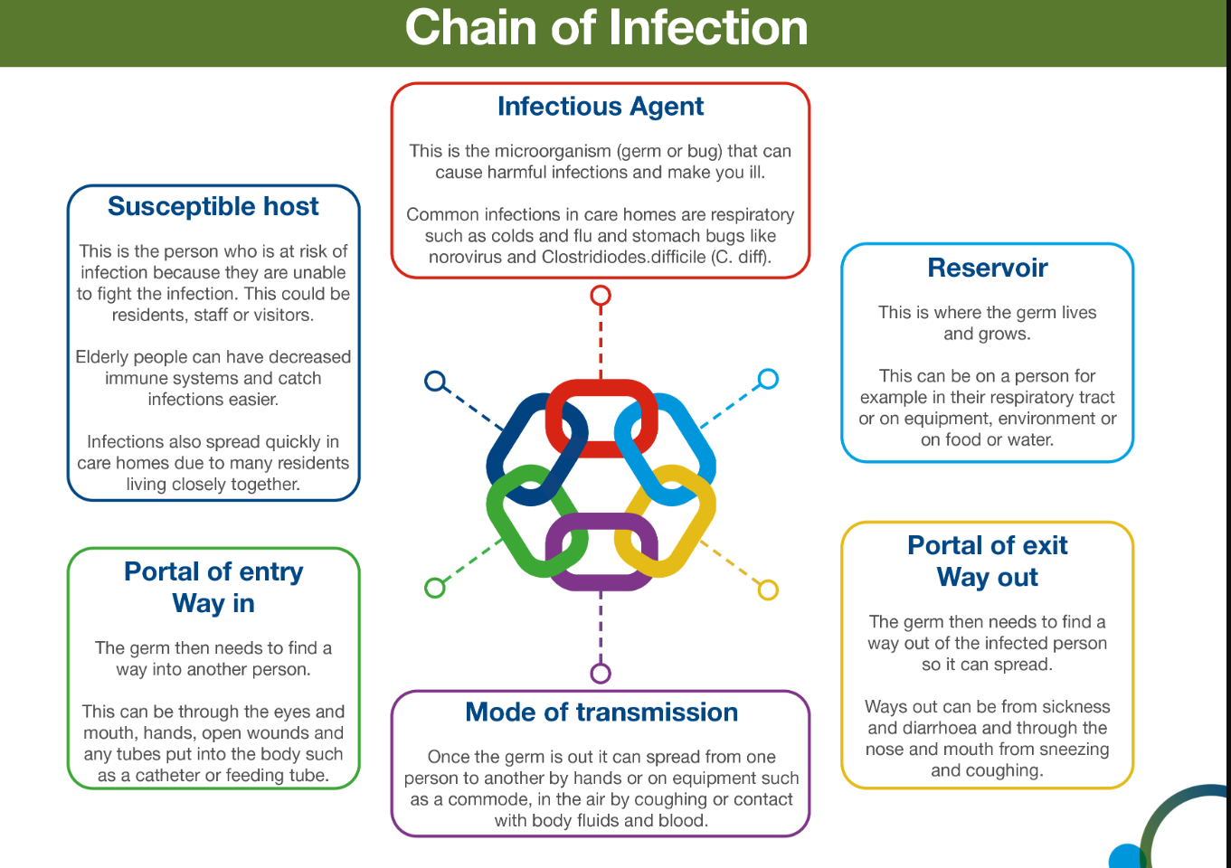

Slide 4
Standard infection control precautions (SICPs)
The National Infection Prevention and Control Manual (updated May 2024) for England states that SICPS are to be used by all staff, in all care settings, for all patients/residents/service users whether infection is known to be present or not
1. Patient placement | 6. Safe management of care equipment
2. Hand hygiene | 7. Safe management of healthcare linen
3. Respiratory and cough hygiene | 8. Safe management of blood and body fluids
4. Personal Protective Equipment (PPE) | 9. Safe disposal of waste (including sharps)
5. Safe management of the care environment | 10. Occupational safety / managing prevention of exposure (including sharps)

Slide 5
1. Correct patient placement
Assessing for infection risk on arrival to the care setting or patients own home, is vital
Those who may present as a infection risk include: diarrhoea & or vomiting, respiratory symptoms, Meticillin-resistant Staphylococcus aureus (MRSA) and Multidrug Resistant Organism (MDRO)
Continue to assess infectious risk throughout their period of care
If a person is identified as having an infection risk, this should be reflected in care planning and good communication with staff is key

Slide 6
2. Hand hygiene
Hand hygiene is considered one of the most important ways to reduce the transmission of infectious agents that cause healthcare associated infections (HCAIs)
Points to remember
Staff MUST be bare below the elbow
Hand hygiene MUST be performed using the WHO 5 moments for hand hygiene
Use Ayliffe technique when decontaminating hands
Choose the correct hand hygiene products
Liquid soap and water should be used when your hands have been exposed to bodily fluids or suspected/known gastrointestinal infection i.e., Clostridioides difficile
Alcohol gel – used when hands are visibly clean
Care for their hands
Appropriate hand hygiene facilities
Staff must have access to liquid soap, paper towels and alcohol gel at all times

Slide 7
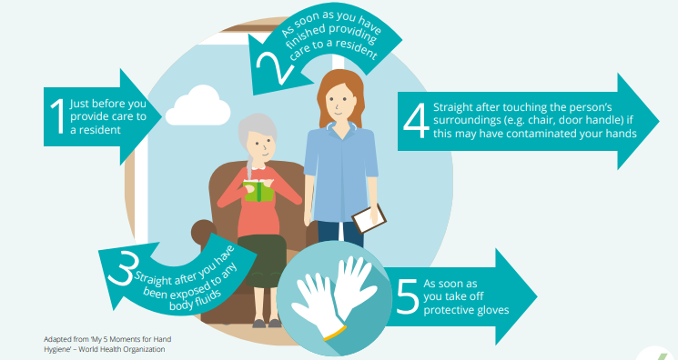
2. Hand hygiene:
The 5 moments for hand hygiene

Slide 8
3. Respiratory and cough hygiene
Cover nose and mouth with a disposable tissue when sneezing
Prompt disposal of all used tissues into waste bin
Wash hands with liquid soap and water after coughing, sneezing, using tissues
Keep contaminated hands away from eyes and nose

Slide 9
4. Personal Protective Equipment (PPE)
Before undertaking any procedure, staff should assess any likely exposure to blood and/or other body fluids
And wear PPE that adequately protects them
PPE must be:
Located close to point of use - (for domiciliary visits PPE must be transported in clean receptacle in car)
Stored to prevent contamination in a clean, dry area
Single use, unless specified by manufacturer
Applied and removed correctly and in the correct order
Changed immediately after each person/procedure or task
Disposed of correctly
Hand hygiene must be undertaken prior to putting on/taking off PPE

Slide 10
4. Personal Protective Equipment (PPE)
Gloves/Aprons must be:
Changed if perforated/ripped/contaminated
Appropriate for use, fit for purpose and well-fitted
NB: double gloving is not recommended for routine care
Gowns or coveralls must be:
Worn when there is a risk of extensive splashing of blood/body fluids
Worn when disposable apron provides inadequate cover
Worn if performing an aerosol generating procedure (AGP’S)
Eye protection must be:
Worn if risk of blood and/or body fluid exposure to the eyes or face is anticipated or likely
During AGP’S
Worn when caring for a person suspected or confirmed COVID 19/respiratory illness

Slide 11
4. Personal Protective Equipment (PPE)
Fluid Resistant Surgical Facemask (FRSM) act:
As a means of source control e.g. to protect the person from the wearer
As protection for the wearer
Key points:
Wear with eye protection if splashing or spraying of blood/body fluids
Well fitting and fit for purpose, fully covering the mouth and nose
Worn correctly and not to be touched once put on
Should be changed if they become moist, damaged, contaminated or soiled
Worn in line with current guidance

Slide 12

5. Safe management of care equipment
Care equipment is easily contaminated with microorganisms, this can pose a cross infection risk
Care equipment is either classified as:
single use: equipment which is used once on a single person then discarded
single patient use: equipment which can be reused on the same person and will require decontamination in-between use such as nebuliser masks
Reusable non-invasive equipment: (often referred to as communal equipment) – can be reused on more than one person following decontamination, eg commode, observation equipment, hoist
Key points
Decontamination schedules, if in use, must specify who is responsibility, frequency & method of decontamination
If equipment is being sent for service or repair via third party, a decontamination status certificate will be required
Care equipment must be in good condition and easily cleanable

Slide 13
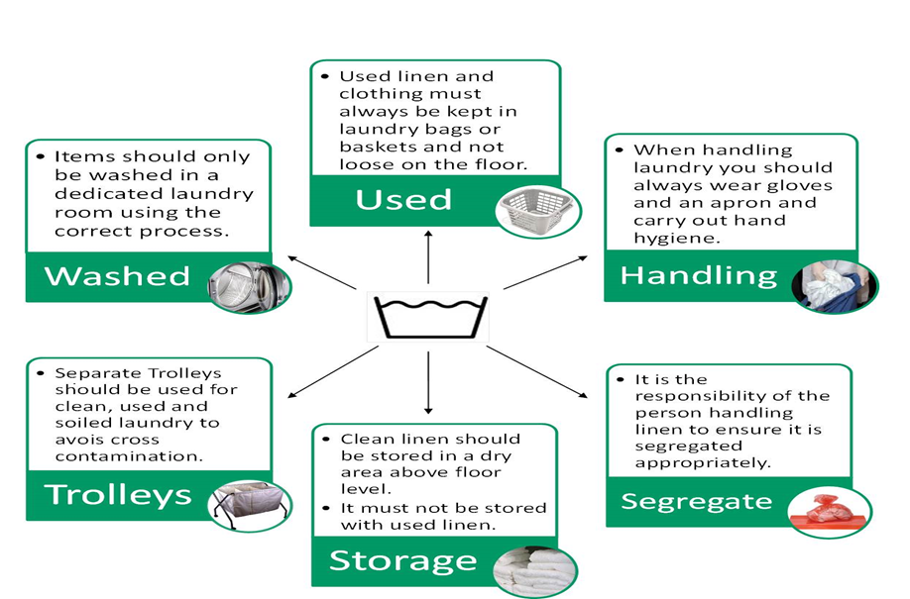
7. Safe management of healthcare linen

Slide 14
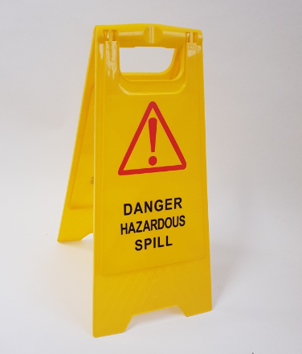
8. Safe management of blood and body fluid spillages
Blood and body fluids may contain high concentration of micro organisms
Refer to appendix 9 (IPC manual) – Best management of blood and body fluid spills
N.B. 10,000 parts per million available chlorine solution is required for blood/some bodily fluid spills
Consider use of spill kits if available

Slide 15
9. Safe disposal of waste: sharps
Sharps container should be fully assembled and labelled correctly (date of assembly and disposal)
Keep handling to a minimum, never pass from hand to hand
Only the user should dispose of used sharp, at point of use
Do not fill above manufacturers marked line
Do not place unnecessary items into sharps container
Temporary closure mechanism must be used when not in use or transporting the sharps container
Store containers appropriately and safely
Sharps containers not to exceed the 3 month rule

Slide 16
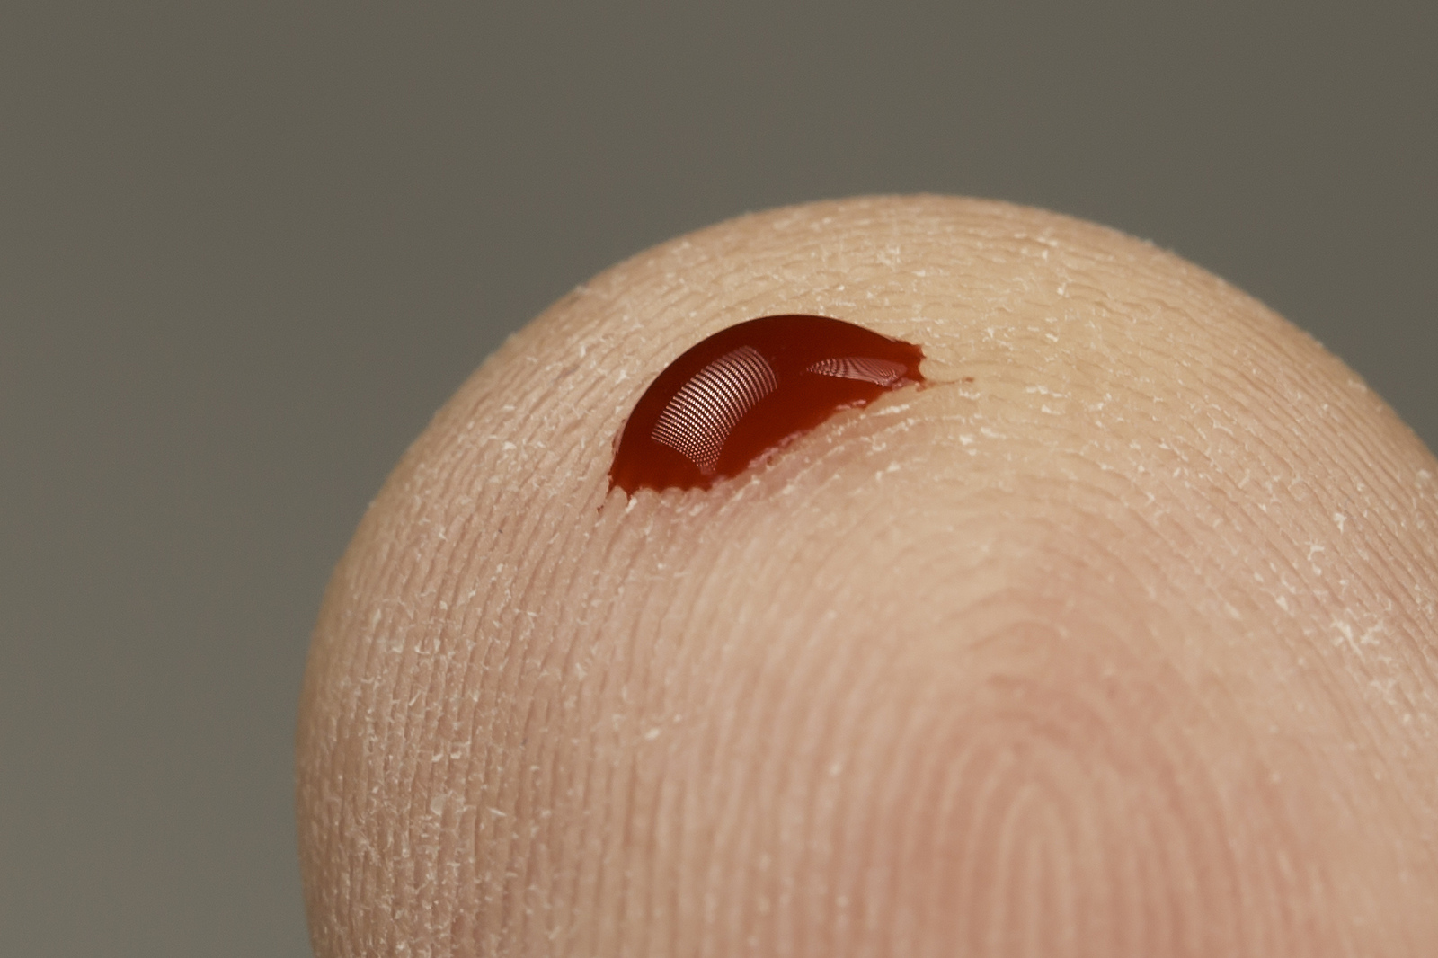
Occupational safety: prevention of exposure
A significant occupational exposure can pose risk for transmission of a blood borne virus (BBV)
Staff must understand the actions they should take when an incident takes place
There is a legal requirement to report all sharps injuries and near misses to line managers/employers
What is a significant occupational exposure?
A percutaneous injury - e.g. injury from needle, instrument and a bite(s) that causes a break to the skin
Exposure of broken skin – abrasions, cuts, eczema
Exposure of mucous membranes (including eyes) – from splashing of blood or other high risk body fluids

Slide 17
Management of Inoculation Injuries
Wash site with soap and water and cover
Inform manager
Complete incident report
No further action
Skin Intact
Penetration of sterile sharp object
Encourage bleeding
Do not suck
Wash site with soap and water and cover
Identify and dispose of sharps correctly
Inform manager
Penetration or abrasion of skin by a contaminated sharp object, instrument, needle, human bite or scratch involving broken skin
Refer to employer’s policy
Blood splash – into eyes, nose, mouth or broken skin
Irrigate with copious amounts of water (before and after removal of contact lenses)
Water to rinse the mouth should not be swallowed
Inform manager

Slide 18
What is an outbreak
An outbreak is defined as 2 or more positive (or clinically suspected) linked cases - staff and/or residents/service users)
Prompt recognition, response/management and reporting of suspected outbreaks is essential to minimise spread of infection – report to IPC service 0151 604 7750 (out of hours UKHSA – 0344 225 0562) staff should be aware of how to manage evolving situations.
Educate staff on how to recognise signs of an outbreak and what actions they should take.
Effective prompt recognition and management of outbreaks can reduce spread within care settings and help to keep everyone safe

Slide 19
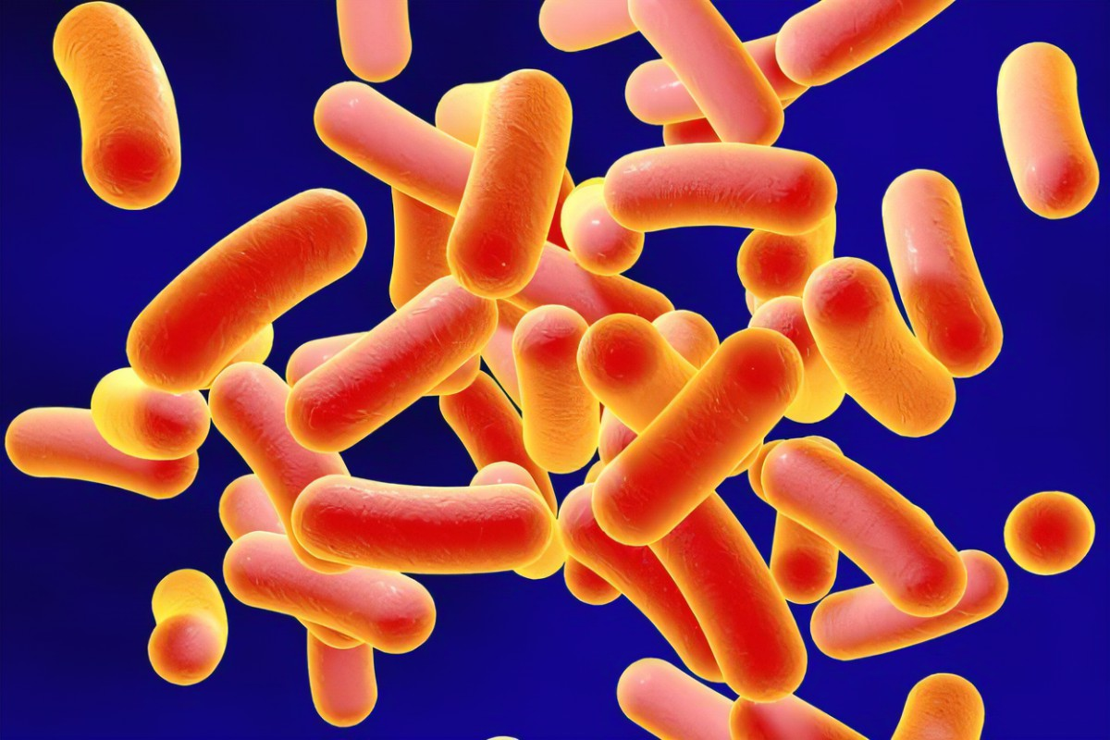
Clostridioides difficile
What is it ?
Clostridioides difficile (also known as C.difficile, C.diff or CDI) is a spore forming bacteria which can be found in the large intestine. Some antibiotics can disturb the balance of the gut flora and cause diarrhoea, this can cause the C.diff to multiply and produce toxins. The toxins may damage the lining of the intestine and produce symptoms ranging from watery diarrhoea to life threatening colitis.
Risk factors include:
Age over 65 years or over
Recent treatment with broad spectrum antibiotics
Recent contact with healthcare settings
On proton pump inhibitor
Underlying health disease

Slide 20
Clostridioides difficile
Transmission
Faecal oral route
Direct person to person contact
Contaminated hands
Contaminated environment -spores can live in the environment for months

Slide 21
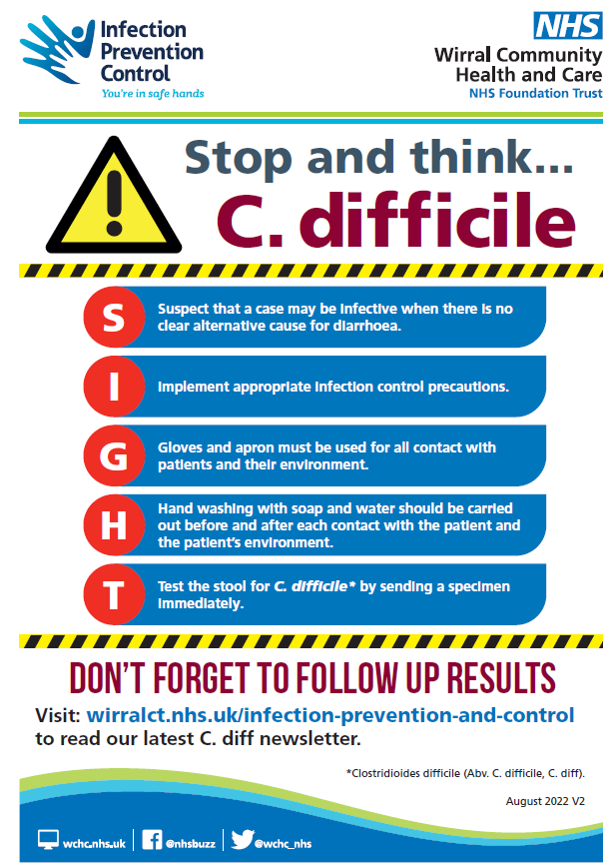
Use the SIGHT acronym when unexplained diarrhoea is present

Slide 22
Meticillin Resistant Staphylococcus Aureus (MRSA)
Staphylococcus aureus (S. aureus) is found on about a third of the population. It usually lives in the moist areas such as armpits, groin and nose. Mostly, it causes no problems, though like any other germ, it can cause infections.
MRSA is when S. aureus becomes resistant to meticillin, meaning that there is a reduced choice of antibiotics available to treat it.
How is MRSA spread?
direct person to person contact
contaminated hands
contaminated environment

Slide 23
Meticillin Resistant Staphylococcus Aureus (MRSA)
Key points
All people newly diagnosed with MRSA should be offered decolonisation therapy regardless of risk factors
Decolonisation regimes are only 50 - 60% effective for long-term clearance
Decolonisation will also reduce the risk of transmission into any wounds or indwelling devices
It is the clinicians responsibility to assess if decolonisation is required
Routine screening is not required following decolonisation (unless specific request has been made)

Slide 24
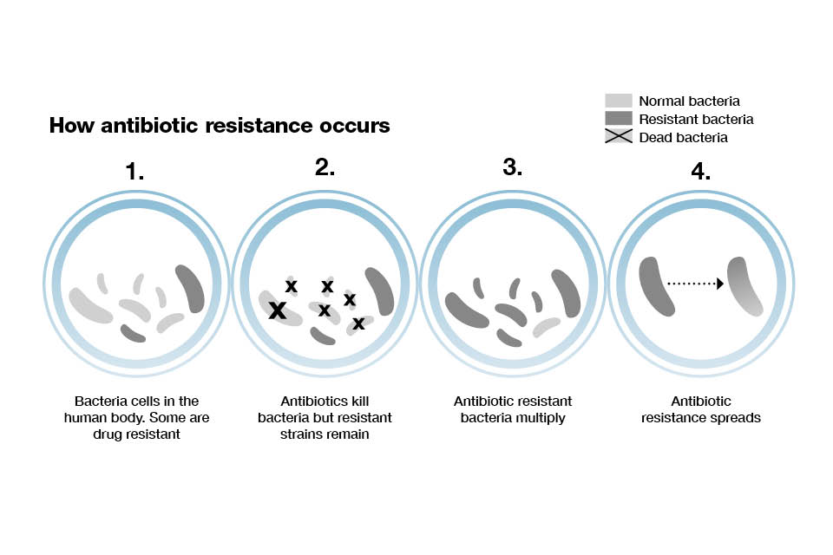
Antibiotic Resistance
Antimicrobial or antibiotic resistance, is when the bacteria learn how to protect themselves from being killed by antibiotics.
These resistant bugs can multiply and spread so that eventually, the antibiotics don’t work at all.
Antibiotic resistance remains one of the biggest threats facing us today
Without effective antibiotics many routine/treatments will become dangerous
When the microorganisms become resistant to most antimicrobials they are often referred to as “superbugs”

Slide 25
Preventing the spread of antibiotic resistance…
What can we do….
Always follow correct advice when using antibiotics i.e. take antibiotics as prescribed
Talk to the patients/residents about how to take antibiotics correctly, antibiotic resistance and the dangers of misuse
Prevent infections by regularly washing hands – poor infection prevention & control can increase the spread of drug-resistant infections
Appropriate specimen collection
Become an antibiotic guardian https://antibioticguardian.com/

Slide 26
Preventing spread of infection
Encourage people to have their Flu and COVID-19 seasonal vaccinations and boosters, this offers the best protection against the viruses.
Follow and reinforce basic infection prevention with good hand and respiratory hygiene and correct use of personal protective equipment.
Maintain good ventilation in the setting
Ensure well maintained supplies/stocks of PPE and hand hygiene products.
Any person displaying symptoms of Acute Respiratory Illness (ARI) should follow most recent guidance, remember this can sometimes change quickly and without notice.

Slide 27
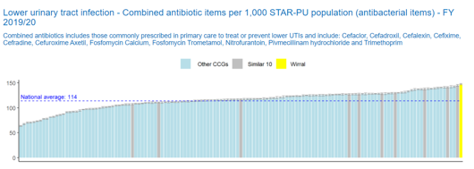
UTI improvement
In Wirral, we are the highest prescribers of antibiotics for urinary tract infections.
We have among the highest rate for admissions to hospital for UTI in England particularly in 70+ population
We need to focus on preventing UTI to keep our older people well

Slide 28








Wirral is working together to improve hydration and prevent and improve treatment of Urinary Tract Infections
Based on To Dip or Not to Dip
A quality improvement project to improve the diagnosis of Urinary Tract Infections (UTIs)
Version 2 (July 2024). Review date: March 2026

Slide 29
References
Infection prevention and control in care homes - Care Quality Commission (cqc.org.uk)
https://www.england.nhs.uk/publication/national-infection-prevention-and-control/
https://www.england.nhs.uk/publication/national-standards-of-healthcare-cleanliness-2021/
https://antibioticguardian.com/
https://www.wchc.nhs.uk/services/infection-prevention-and-control/

Slide 30
Thank you for listening….
Contacting the team:-
Our email address ipc.wirralct@nhs.net or by telephone 0151 604 7750
IPC DIGITAL HUB- Infection Prevention and Control - Wirral Community Health and Care NHS Foundation Trust (wchc.nhs.uk)
Please complete post session evaluation via the QR code

