Slide 1


IPC Bitesize Training
for Adult Social Care
Infection Prevention Control Service

Slide 2
Clostridioides difficile and the Management of Unexplained Diarrhoea

Slide 3

Clostridioides difficile
What is it ?
Clostridioides difficile (also known as C.difficile, C.diff or CDI) is a spore forming bacteria which can be found in the large intestine. Some antibiotics can disturb the balance of the gut flora and cause diarrhoea, this can cause the C.diff to multiply and produce toxins. The toxins may damage the lining of the intestine and produce symptoms ranging from watery diarrhoea to life threatening colitis.
Risk factors include:
Age over 65 years or over
Recent treatment with broad spectrum antibiotics
Recent contact with healthcare settings
On proton pump inhibitor
Underlying health disease

Slide 4
Clostridioides difficile
Transmission
Faecal oral route
Direct person to person contact
Contaminated hands
Contaminated environment -spores can live in the environment for months
Key learning from recent post infection reviews:
Delays in stool sample collection
Delays in treatment
Loperamide use
Gaps in sending specimens – i.e out of hours

Slide 5
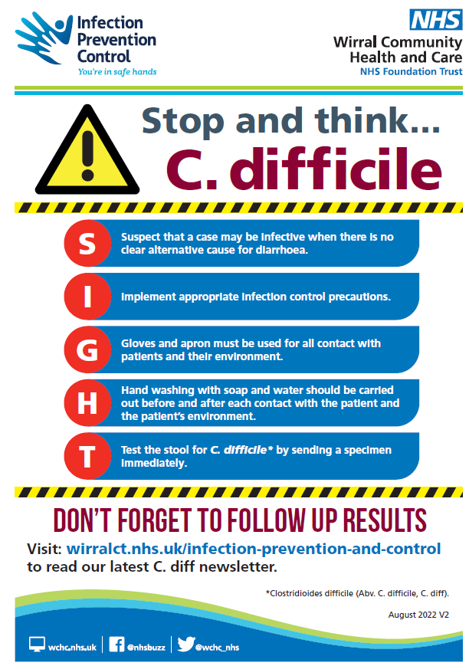
Use the SIGHT acronym when unexplained diarrhoea is present

Slide 6
Thank you for listening….
Contacting the team:-
Our email address ipc.wirralct@nhs.net or by telephone 0151 604 7750
IPC DIGITAL HUB- Infection Prevention and Control - Wirral Community Health and Care NHS Foundation Trust (wchc.nhs.uk)
Please complete post session evaluation via the QR code

