Slide 1


IPC Bitesize Training
for Adult Social Care
Infection Prevention Control Service

Slide 2
Antimicrobial Resistance and Gram Negative Blood Stream Infections

Slide 3
What is antimicrobial resistance?
Antibiotic resistance is a global health and development threat. It is when bacteria change in response to antibiotic medicines being used against them. The more antibiotics are used, the more chance there is that the bugs will change and become resistant to the antibiotics.
When this happens, antibiotics can become less effective and, in some cases, may no longer work. This means some infections will no longer be able to be treated and will therefore become life-threatening.
https://youtu.be/MENdrA8B0N4

Slide 4
What are gram negative bacteria?
There are many different types of Gram-negative bacteria. Some live in the intestine harmlessly, while others may cause a variety of diseases.
Bacteria that are normally harmless in their normal environment can cause problems if they grow in other parts of the body and can cause a range of infections with differing severity and associated mortality. One of the most serious infections Gram-negatives can cause bloodstream infections.
Gram-negative bacteria are the leading causes of healthcare associated bloodstream infections.
Gram-negative bacteria can be resistant to antibiotics and in some cases will be multi-resistant, meaning most available antibiotics will no longer work.

Slide 5
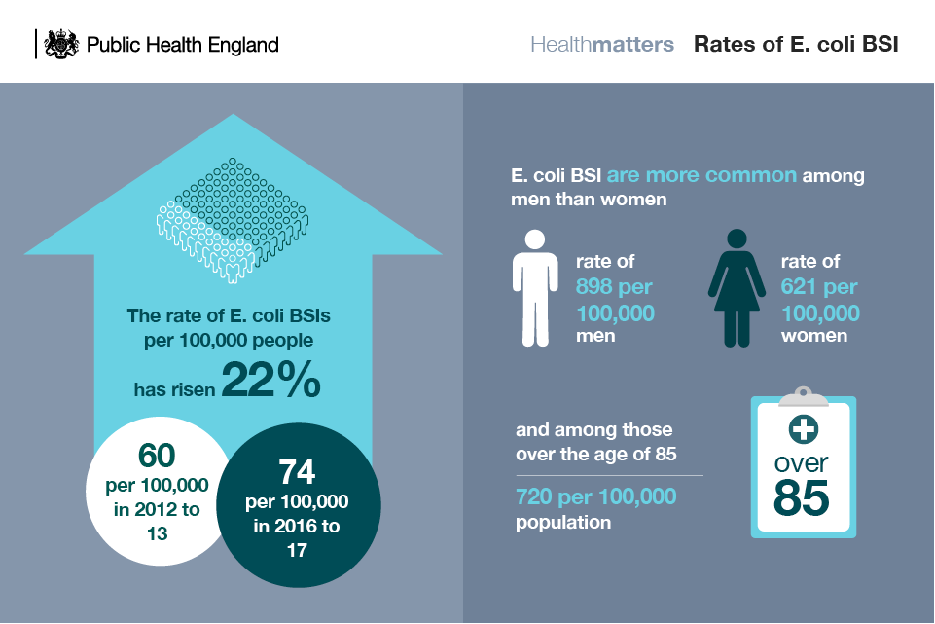
Rates of infections

Slide 6
Thank you for listening….
Contacting the team:-
Our email address ipc.wirralct@nhs.net or by telephone 0151 604 7750
IPC DIGITAL HUB- Infection Prevention and Control - Wirral Community Health and Care NHS Foundation Trust (wchc.nhs.uk)
Please complete post session evaluation via the QR code

