Slide 1

Healthy Lifestyle
(part 1)
Presented by:
Community Dietitian

Slide 2

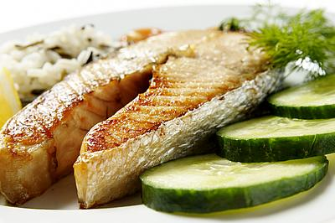
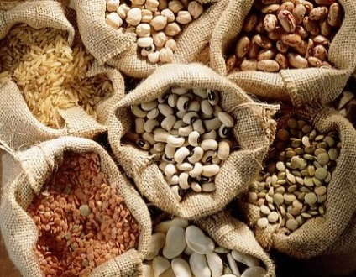
Healthy Eating
More vegetables
Include fruits, whole grains, dairy, oily fish, pulses, and nuts
Limit processed and sugary foods and drinks
Care with portion sizes
Changes that are realistic and achievable

Slide 3
Food Groups
Vegetables and fruit
Starchy carbohydrates
Dairy and alternatives
Protein
Fats
Processed foods/drinks

Slide 4
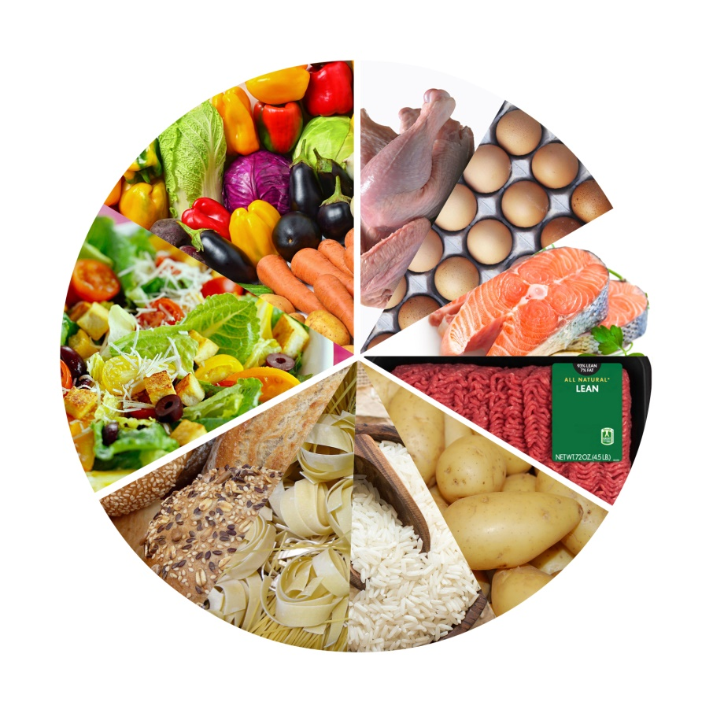
Fruit and vegetables
Contain vitamins, minerals and antioxidants.
Help to keep your heart healthy, reduce the risk of stroke and some cancers.
Prevent constipation
Reduces blood cholesterol.
Aim for 5 or more portions daily
Eat a RAINBOW!! Choose different coloured fruits and vegetables.
Can be fresh, frozen, tinned (dried and juice can also count but take care with portion size!)

Slide 5
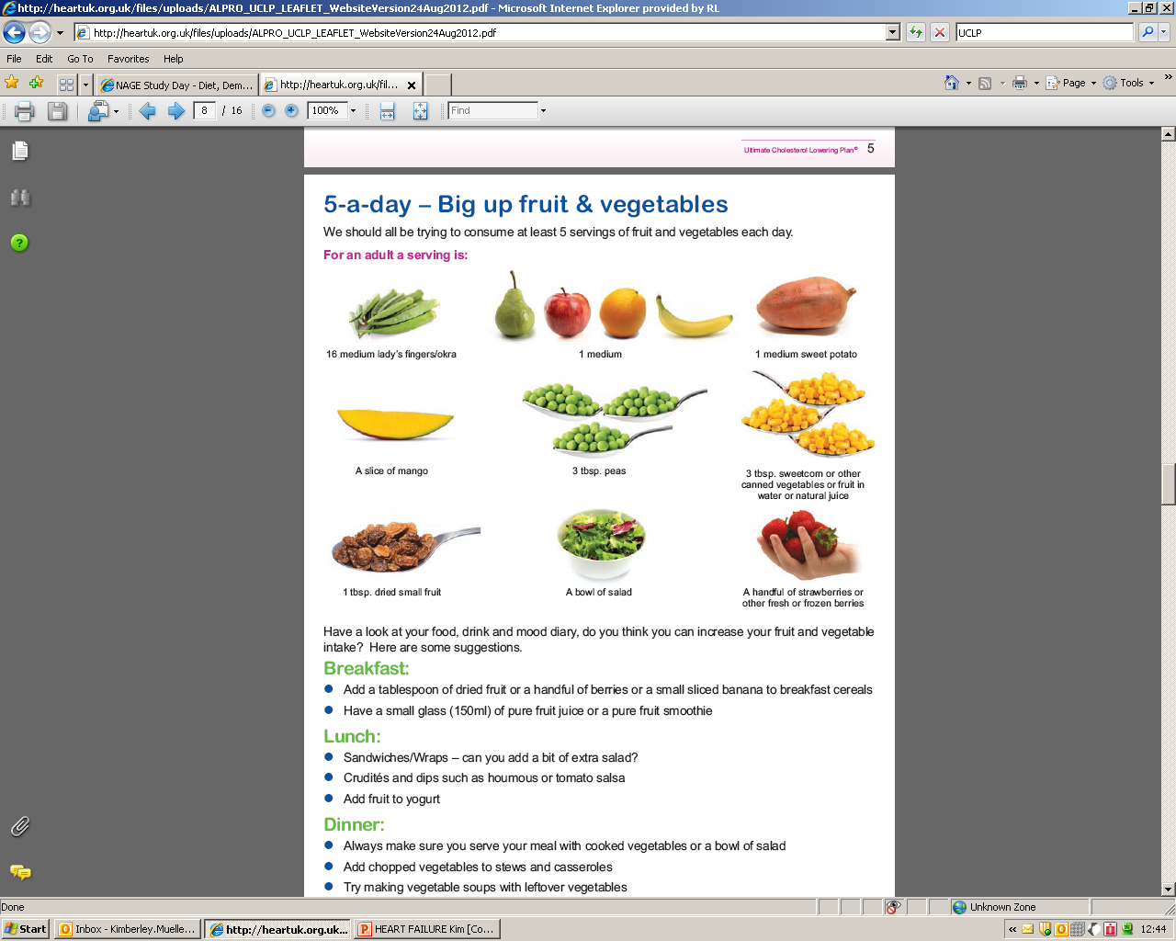
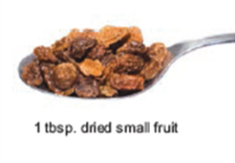

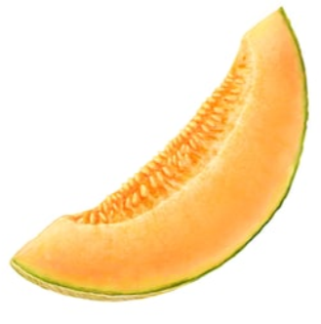
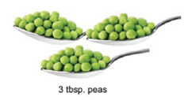
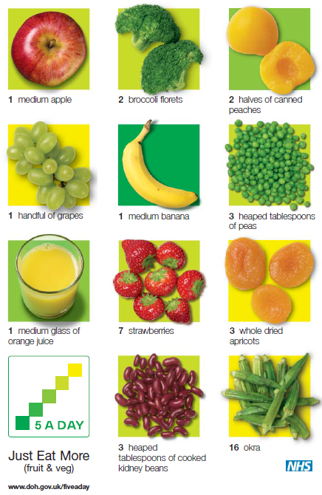
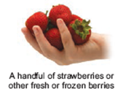
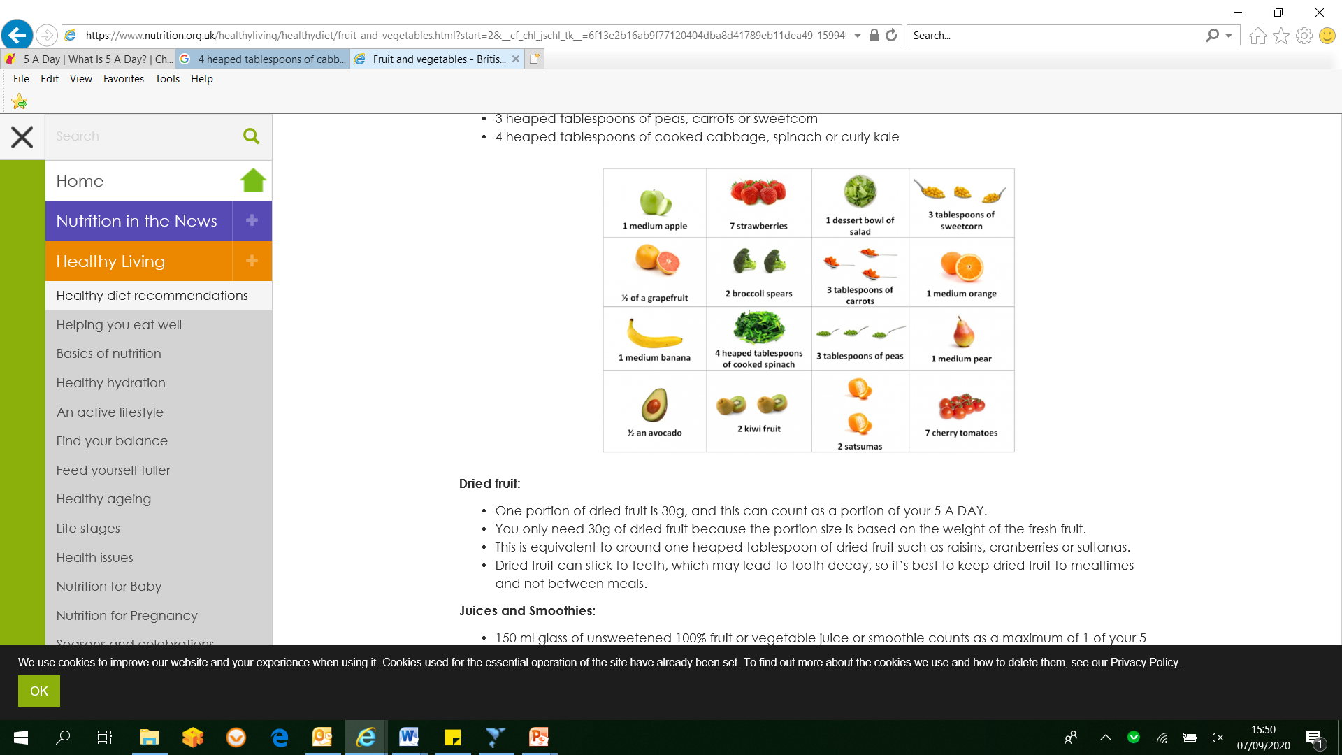
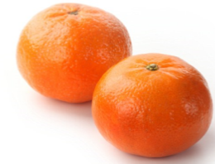
Fruit and vegetables – what is a portion?
80g which is
  2 handfuls (3-4 heaped tablespoons) of vegetables or salad
  a cupped-handful of fruit
30g for dried fruit
150ml for fruit juice – a maximum of 1 glass daily

Slide 6
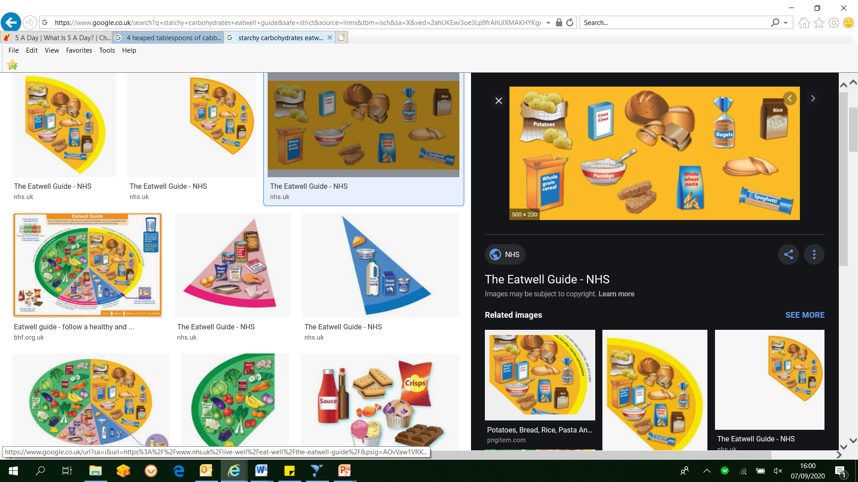
Starchy Carbohydrates
Examples: bread, rice, potatoes, pasta, cereal, crackers, couscous, flour, chapattis, naan, plantain.
Used by the body as an energy source.
Amount required depends on energy needs
All contain carbohydrate and affect blood glucose levels.
Check portion sizes (fist sized portion as a guide)

Slide 7
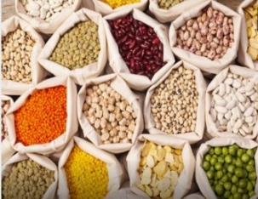
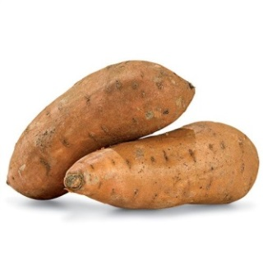
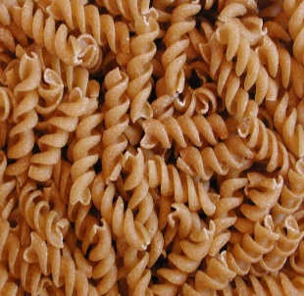
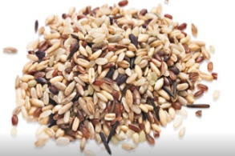
Fibre
Good for digestive health
Associated with a lower risk of cardiovascular diseases, type 2 diabetes and bowel cancer
Linked with improving blood glucose levels, blood fat levels and blood pressure
Keeps you feeling fuller for longer
Even though higher fibre options have health benefits they still contain carbohydrate - Be mindful of portion size.

Slide 8


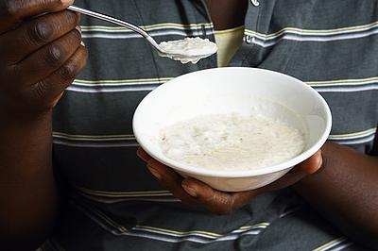
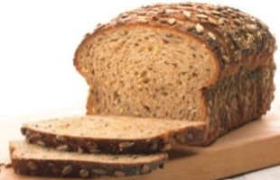

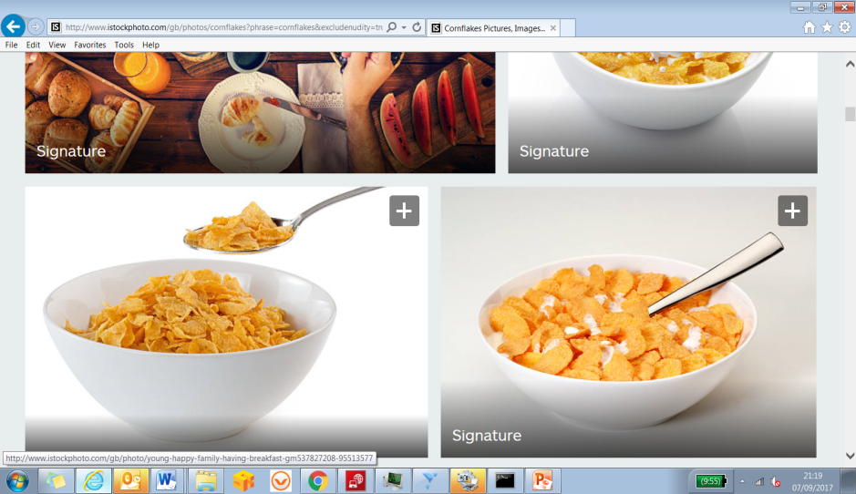
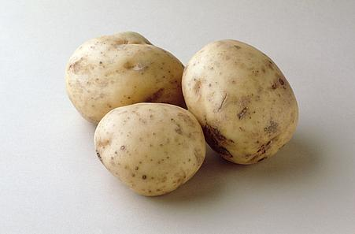
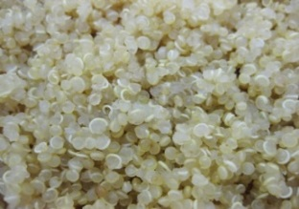
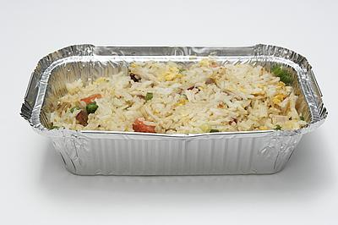
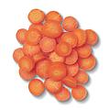
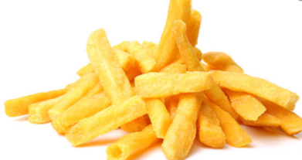
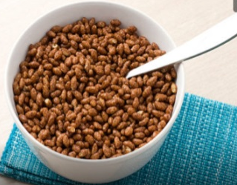
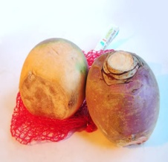
Starchy and sugary foods
Quick burst of energy
Hungry again quickly
Low in vitamins, minerals and fibre
Steady supply of energy
Feel full for longer
High in vitamins, minerals, fibre and some have protein

Slide 9
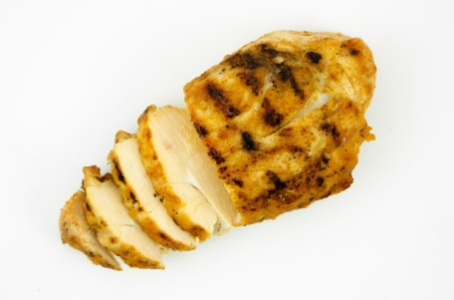
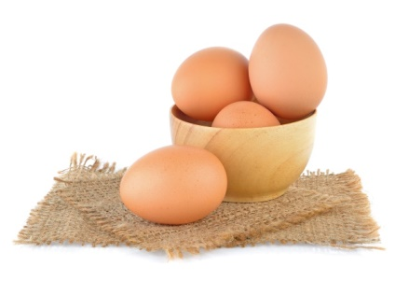
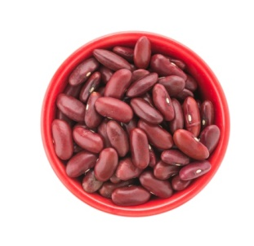
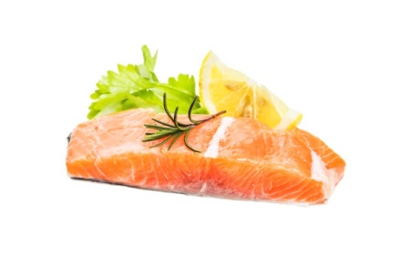
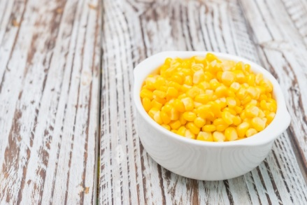
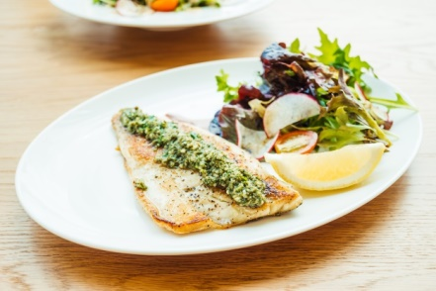
Protein
Used by the body for growth and repair, including muscles
Protein rich foods also contain minerals, such as iron, which are vital for producing red blood cells
Examples: Beans, pulses, fish, eggs, meat, poultry, nuts, other proteins e.g. Quorn, tofu
Portion = palm sized

Slide 10
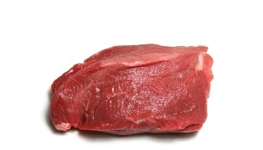
Reduce red and processed meats
Keep to 70g red/processed meat
  This is equivalent to a piece of steak about the size of a pack of cards, 3 rashers of bacon or slices of ham, or a quarter-pounder beef burger.
Red meat refers to beef, lamb and pork
Processed meat refers to meat that has been smoked, cured, salted or has preservatives added. E.g. sausages, bacon, ham, cured meats like salami, pates and reformed meat products.
Eating red and processed meats is linked with a higher risk of bowel cancer.

Slide 11
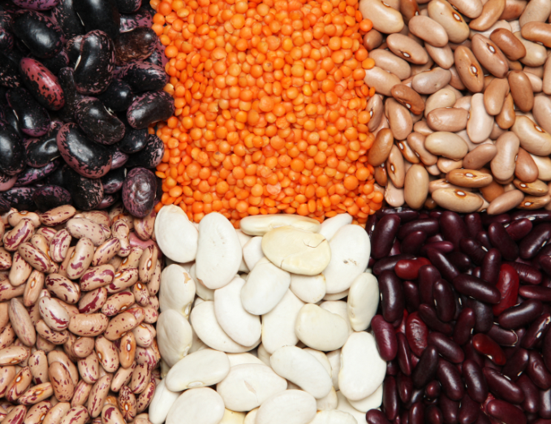
Pulses
Includes all beans, peas and lentils, such as
  baked beans
  red, green, yellow and brown lentils
  chickpeas, black-eyed peas, kidney beans, butter beans, haricots, cannellini beans, flageolet beans, pinto beans and borlotti beans
  garden peas, runner beans, broad beans
low-fat source of protein, fibre, vitamins and minerals
count towards your recommended 5 daily portions of fruit and vegetables.
don’t have a big impact on blood glucose
can help to control blood fats such as cholesterol.
low in cost

Slide 12
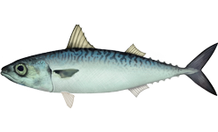
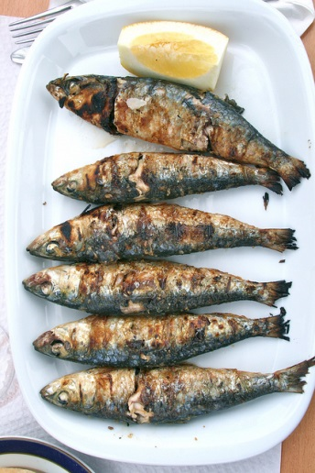
Oily Fish
Examples: Salmon - Mackerel – Sardines - Herring – Pilchards – Sprats – Trout
Aim for two portions of fish per week of which at least one is oily.
One portion = 5oz (140g)

Slide 13
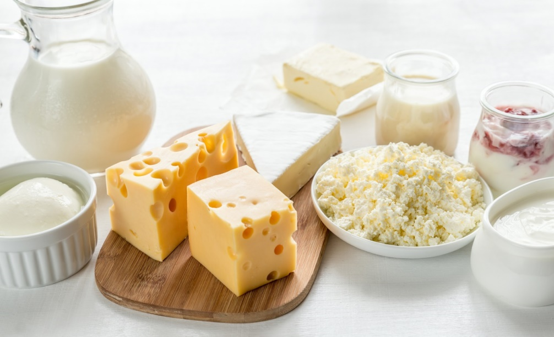
Dairy and alternatives
Provide calcium for strong bones and teeth
Examples: Milk, yoghurt, cheese, calcium-enriched non-dairy versions of these foods

Slide 14
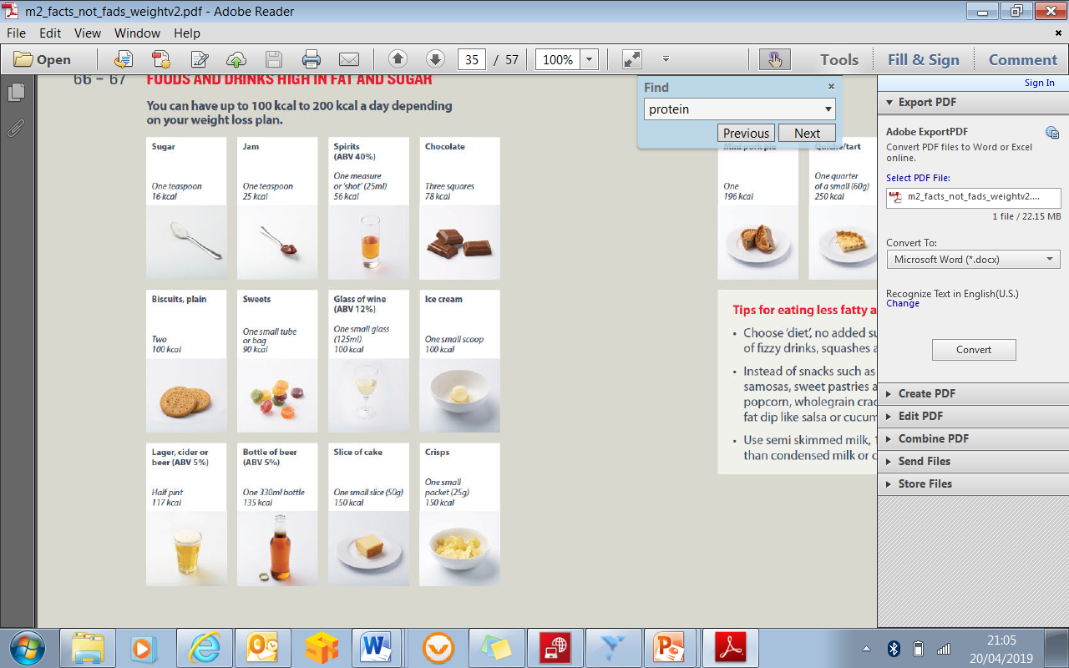
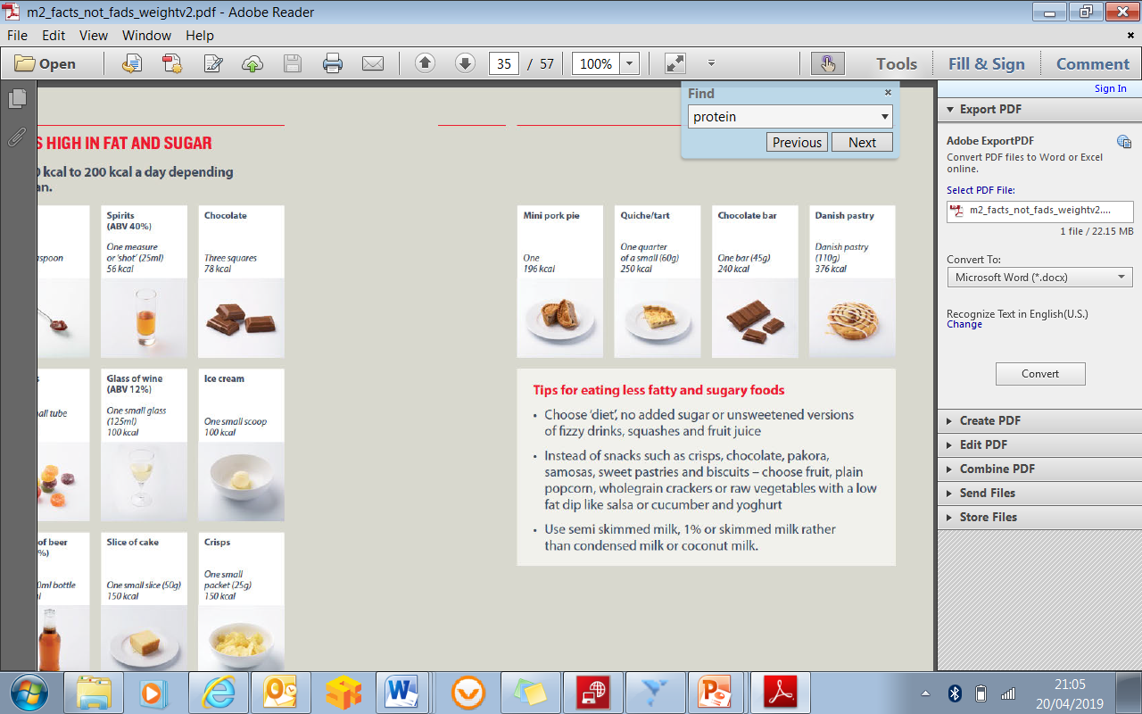
High fat/salt/sugar foods
Not required as part of a balanced diet, so try to include only in small amounts occasionally

Slide 15
Fats
High in calories
If you reduce you fat intake make sure not to replace it with refined carbohydrates or
sugary foods
Main types of fats found in food: saturated and unsaturated fat. Most foods will have a
combination of these.
Reduce amount of saturated fat eaten, have unsaturated fats and oils such as rapeseed
or olive oil, as these types are better for our hearts

Slide 16

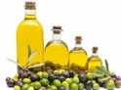
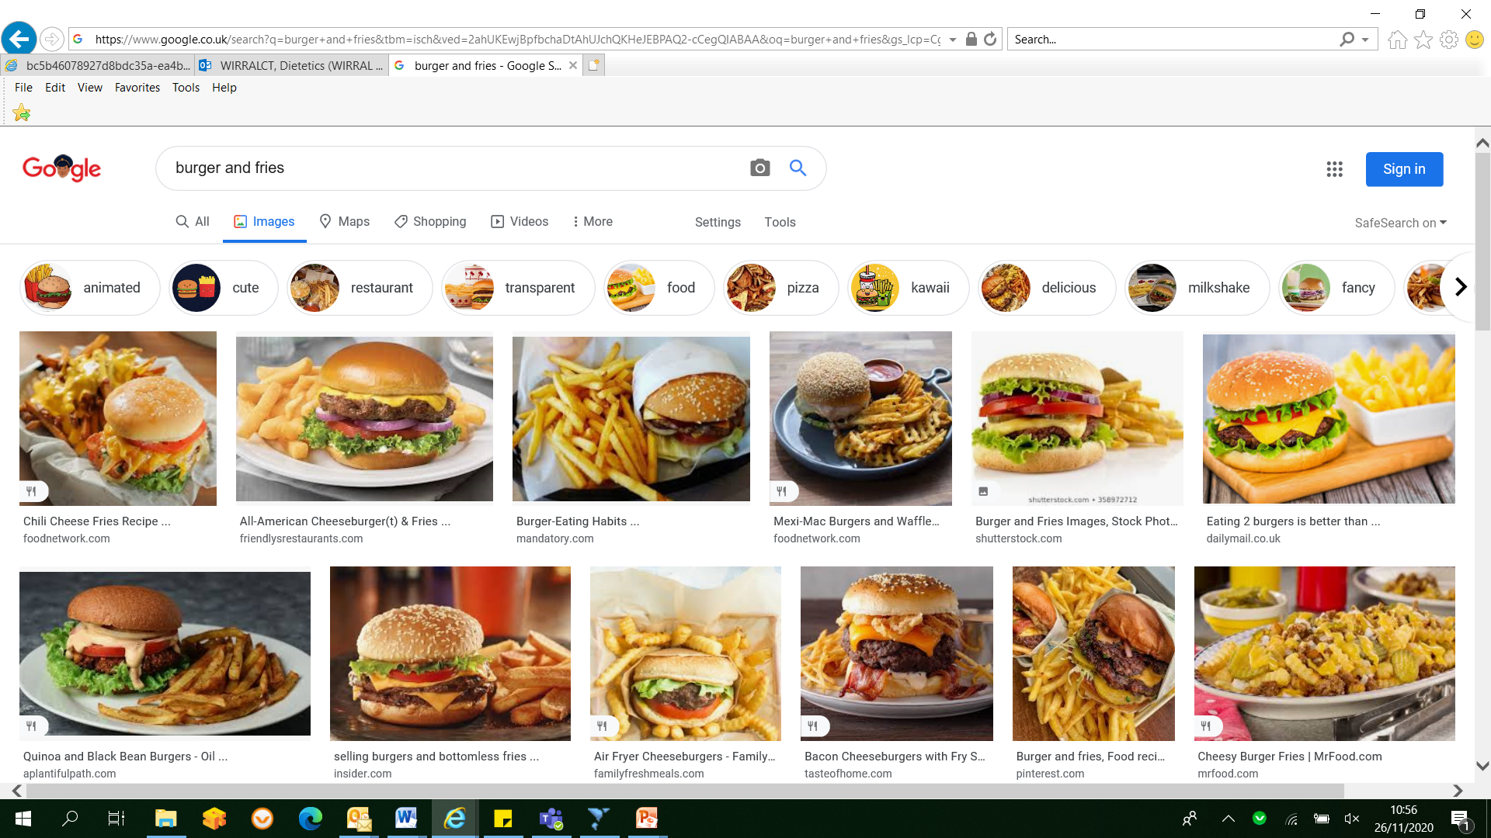
Fats
Saturated fats
Present in higher amounts in animal products, such as: butter, cream, cheese, meat,
meat products and poultry, processed foods like pastries, cakes and biscuits.
Linked with increasing the amount of bad cholesterol (LDL) in the body
Unsaturated fats
Help to maintain the ‘good cholesterol’ (HDL)
Mono- unsaturated fats are present in a higher amount in olive oil, rapeseed oil and avocado.
Polyunsaturated fats - Omega 6 and Omega 3 fatty acids
  Omega 6 found in sunflower, safflower, corn, groundnut and soya oils
  Omega-3 found in oily fish
Trans fats
Increase LDL cholesterol and reduce HDL cholesterol
Takeaway foods , artificially produced trans fats (hydrogenated fats)

Slide 17
Fats
All fats are high in calories - be mindful of portions
Reduce the amount of fat you eat from processed foods
Try to avoid processed (or trans) fats.
Choose healthier fats: oilve oil, rapeseed oil, olives, nuts, seeds, oily fish

Slide 18
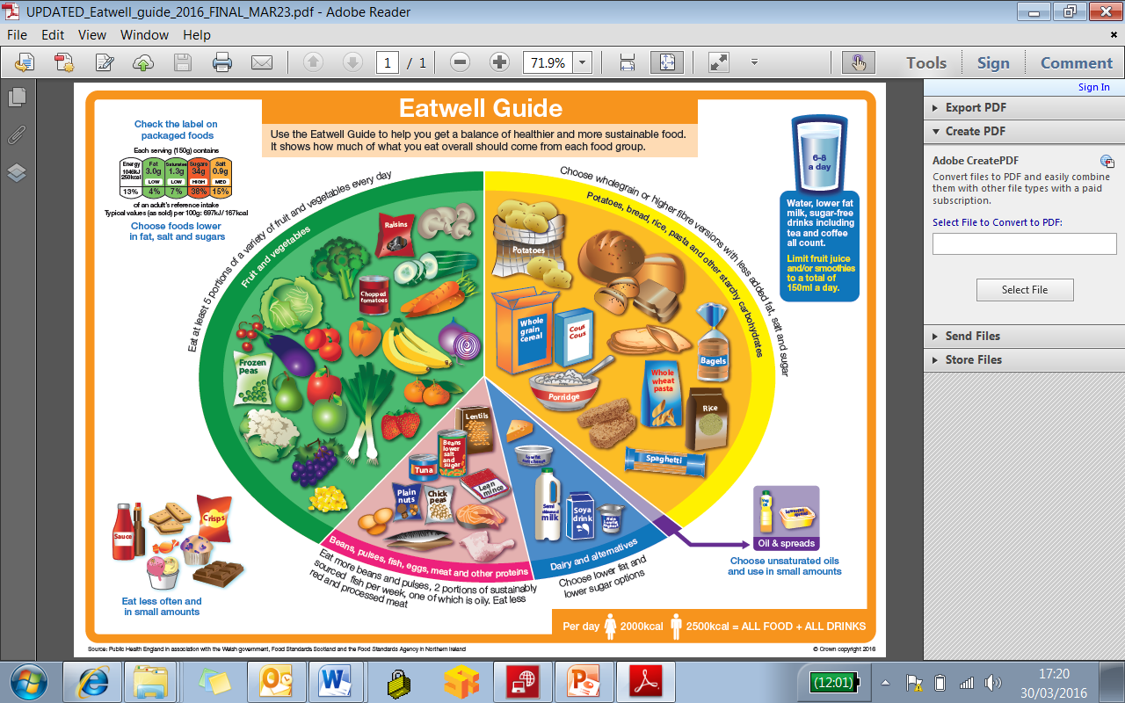

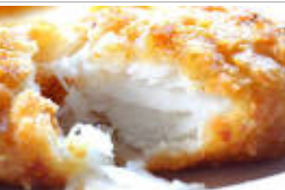
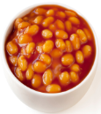
Carbohydrate | No carbohydrate
Sugar and sugary foods/drinks Starchy foods Starchy vegetables (parsnip, sweet potatoes, swede, beet root) Most fruits Milk Yoghurt Breaded/battered meat/fish Baked beans | Most vegetables Cheese Meat Fish Eggs Nuts Butter/fat spreads Oils

Slide 19
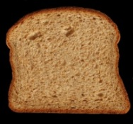

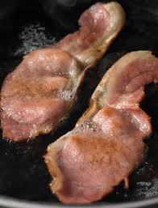

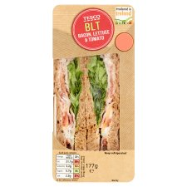
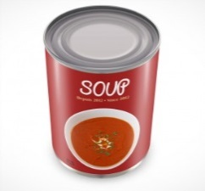
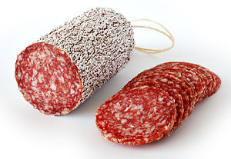
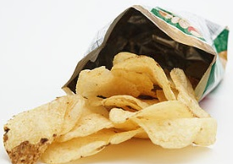

Salt
Recommended less than 6g per day
Increased salt intake can increase blood pressure

Slide 20


Alcohol
No more than 14 units of alcohol each week
You should have several alcohol free days each week

Slide 21




Alcohol units
2 units
1 ½ - 2 units
1 unit
1 ½ units
pint of standard
strength
beer, lager or cider
Small 125ml glass of wine
Single measure of spirits
Bottle of Alco pop
Notes:
1 unit ~
-½ pint of ordinary strength beer, lager or cider (3 to 4% alcohol by volume (ABV))
-small pub measure (25ml) of spirits (40% ABV)
- standard pub measure (50ml) of fortified wine such as sherry or port (20% ABV).
1 ½ units of alcohol in:
-small glass (125ml) ordinary strength wine (12% ABV),
-standard pub measure (35ml) spirits (40% ABV).
Next slide – Why are we recommended to limit alcohol?

Slide 22
Alcohol
Health considerations
Too much increases health risks, including:
Heart disease (raises blood pressure; raises blood fats (triglycerides))
Stroke
Cancer
Liver disease
Weight gain (high in calories)
Carbohydrate content (beers, lagers, ciders, fortified wines, liqueurs mixers)
Choose sugar free mixers
Hypoglycaemia risk (insulin/sulphonylurea treated diabetes)

Slide 23
Alcohol
Check carbohydrate/sugar content
Be mindful of the high calorie content

Slide 24

Protein
Veg/salad
Veg/salad
Protein
Starchy
carbohydrates
Starchy carbohydrates

Slide 25
Thank you for joining us today!

