Slide 1


Food labelling
Presented by:
Community Dietitian

Slide 2
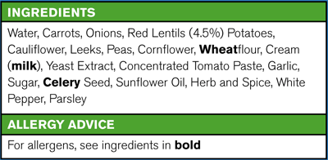
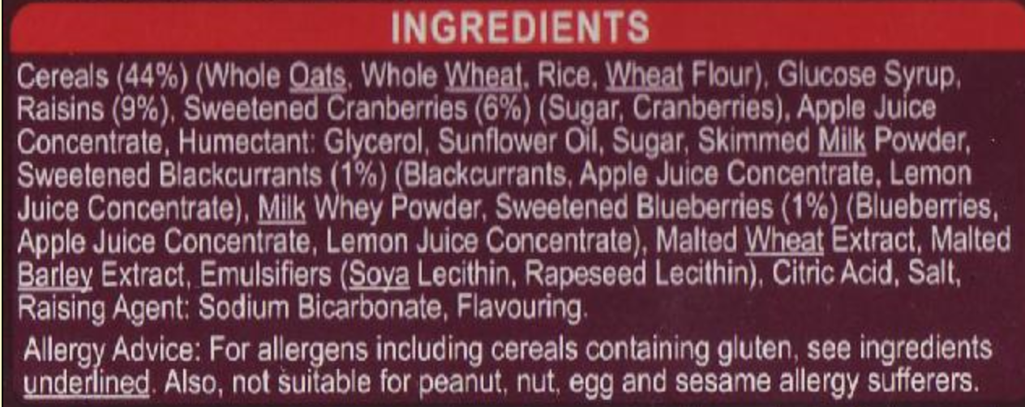
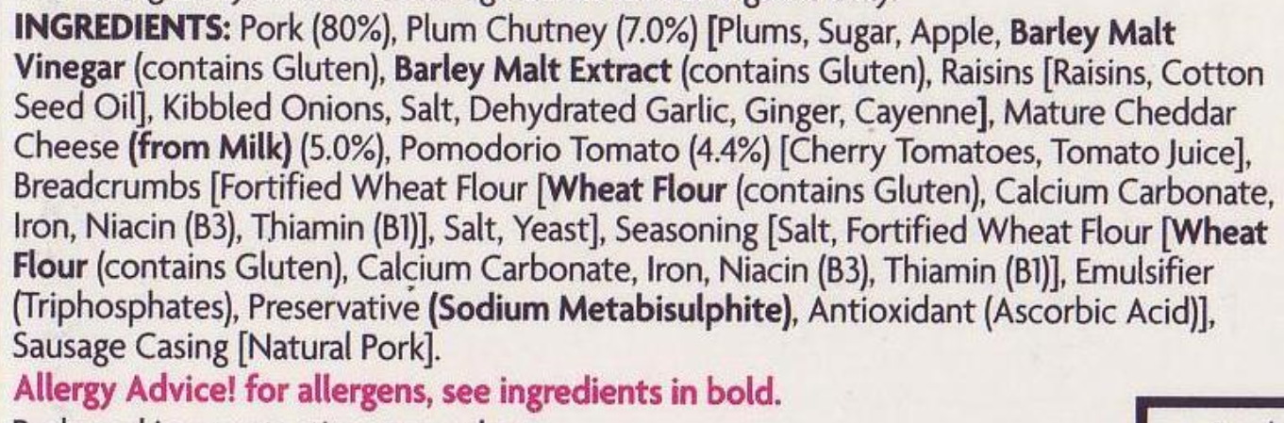

Slide 3
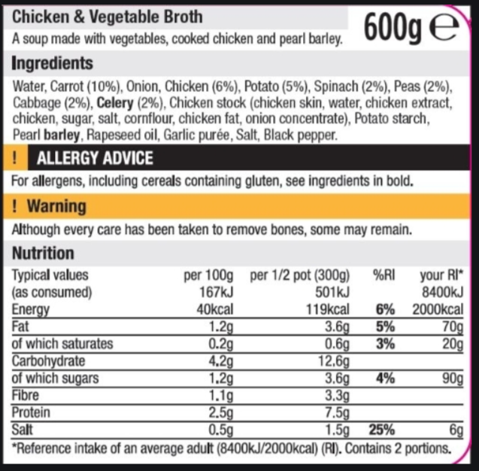

Slide 4
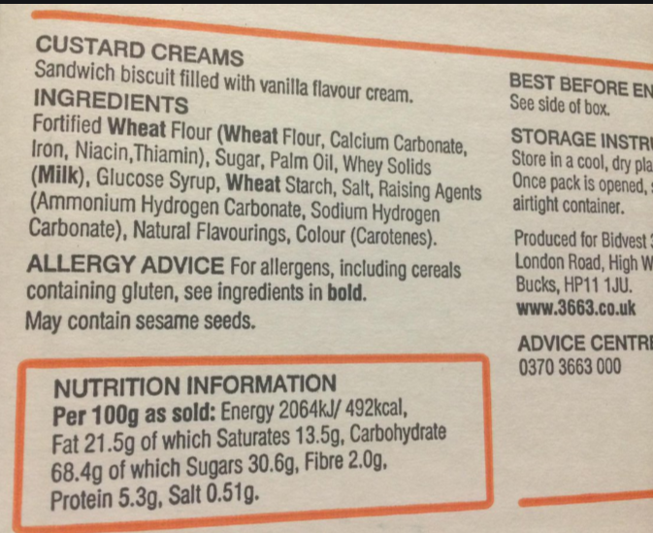

Slide 5
Ingredients List
Ingredients are listed from highest weight/greatest content at the top of the list to the lowest at the bottom.
The first three ingredients therefore give an indication as to what there will be a lot of in that food/drink
Free sugars come in many forms, including:
Soft brown sugar Honey Syrup Invert syrup
Brown rice syrup Golden syrup Cane sugar Molasses
anything ending in ‘ose’ e.g. Fructose, Dextrose, Glucose fructose syrup, Oligofructose syrup

Slide 6
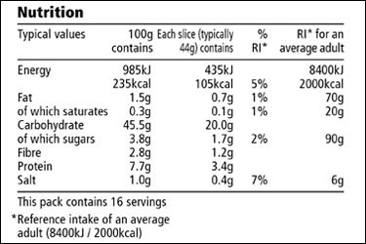
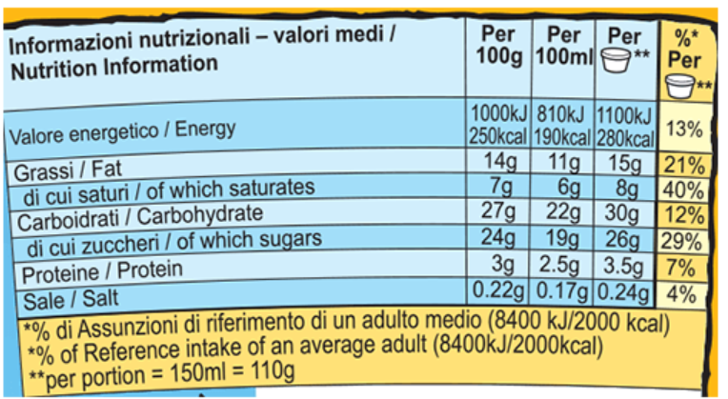
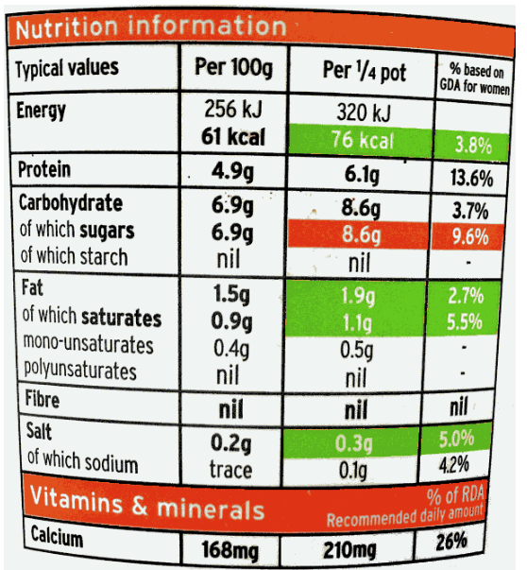
NUTRITION INFORMATION
Typical values per 100ml: Energy:
39kJ/9kcal, Fat:0.5g, of which
saturates 0.3g, Carbohydrate: 0.9g,
of which sugars: 0.2g, Fibre: trace,
Protein: 0.1g, Salt: 0.1g.

Slide 7
Nutrition information
Lists the energy/calories and nutrients in foods.
Energy measures in calories (kcal)
As a minimum labels must also list: Total fat, Saturates, Carbohydrate, Sugars, Protein, Salt
Choose higher fibre options
A ‘source’ of fibre = at last 3g of fibre per 100g or at least 1.5g of fibre per 100 kcal.
‘High fibre’ = at least 6g of fibre per 100g or at least 3g of fibre per 100 kcal.
Some labels will also give information on fibre, vitamins, minerals and other types of fat
‘Total carbohydrate’, rather than ‘of which sugars’ should be the focus of attention when considering the impact that a product is likely to have on blood glucose levels

Slide 8
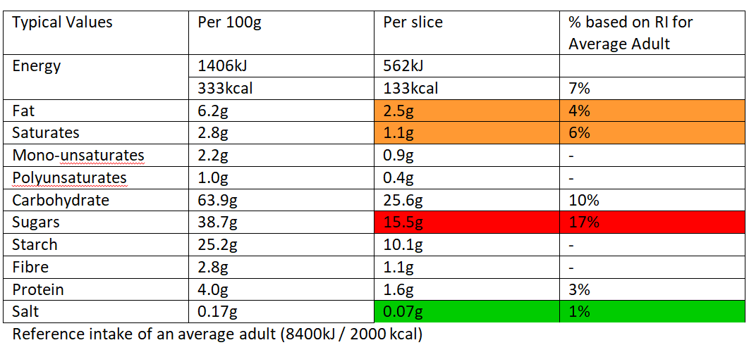
Fruit Cake

Slide 9
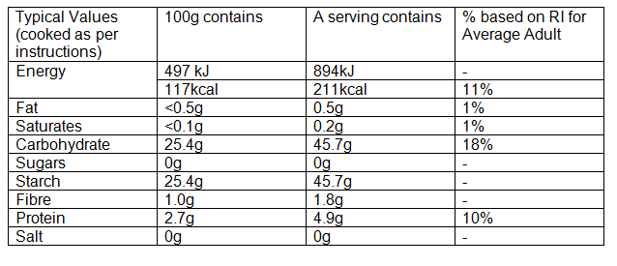
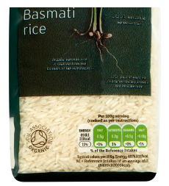
Rice

Slide 10
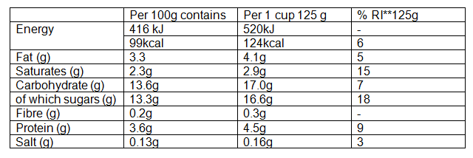
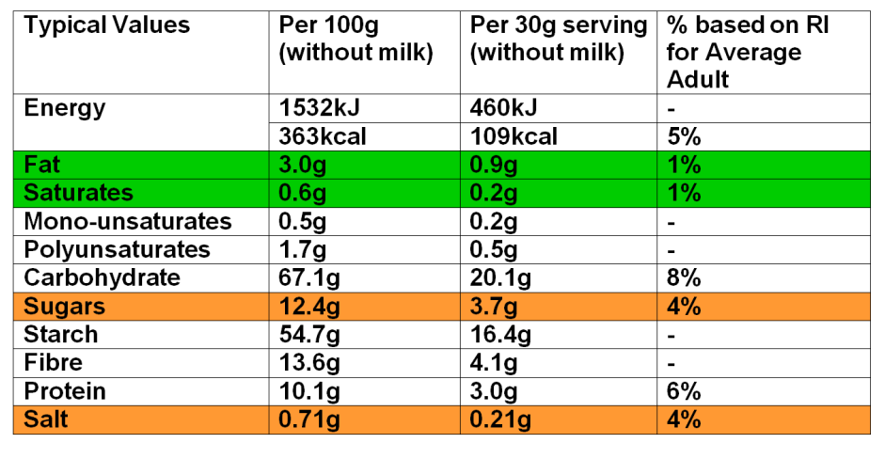
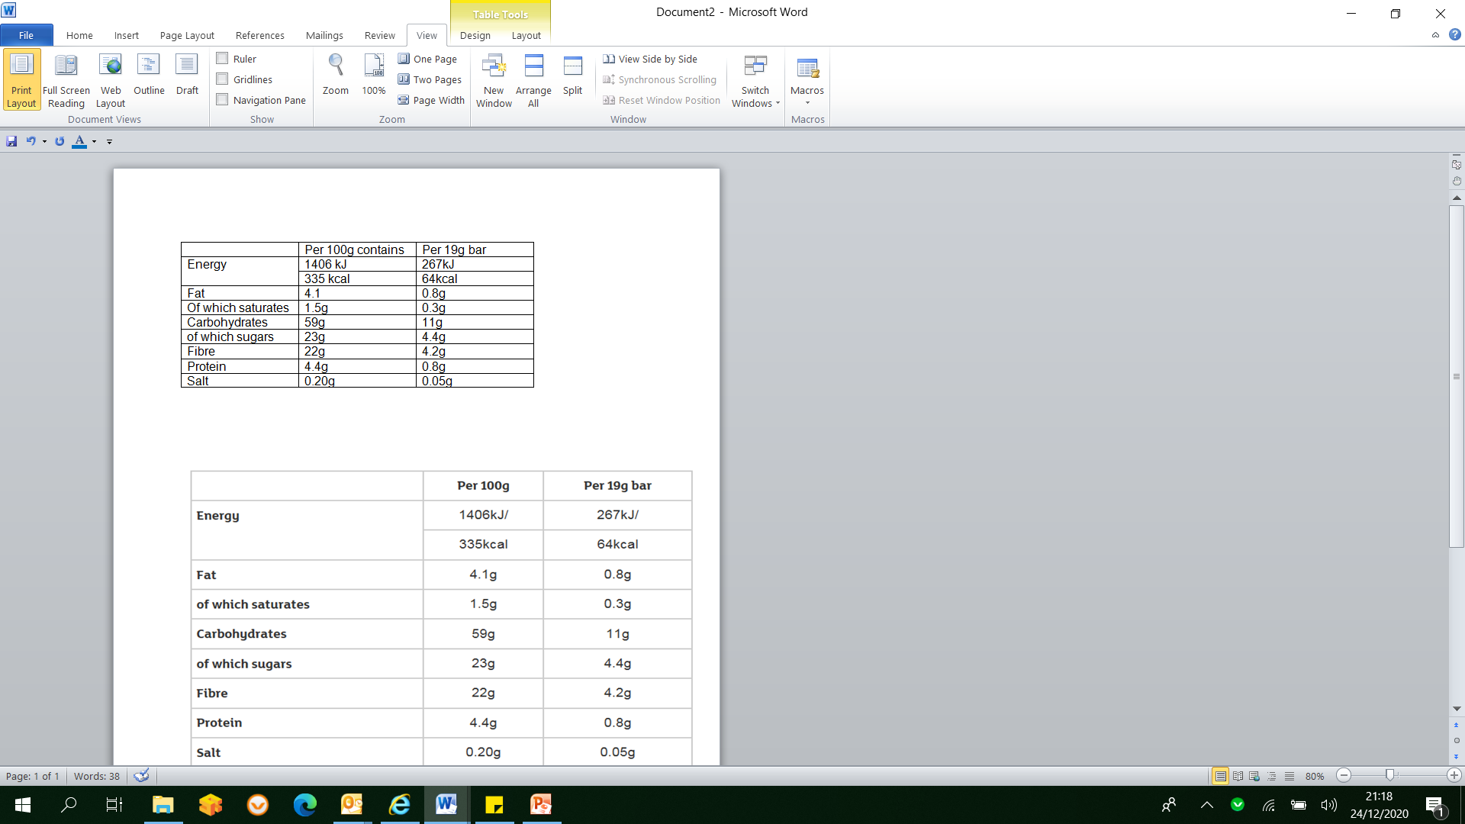
Use per 100g – where you decide the portion size from a larger pack
Use per serving when you eat the set serving size e.g. individual serving packs

Slide 11
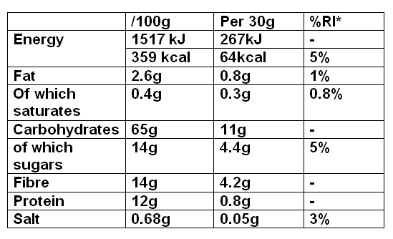
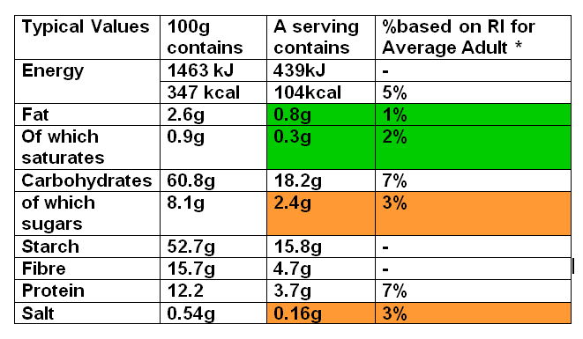
Per 100g example - cereal
Cereal 1
Cereal 2
Notes:
Kellogg’s bran flakes vs Sainsbury’s Bran flakes
Some valuse are lower /100g with the own brand but higher per serving as they have used a higher serving size

Slide 12
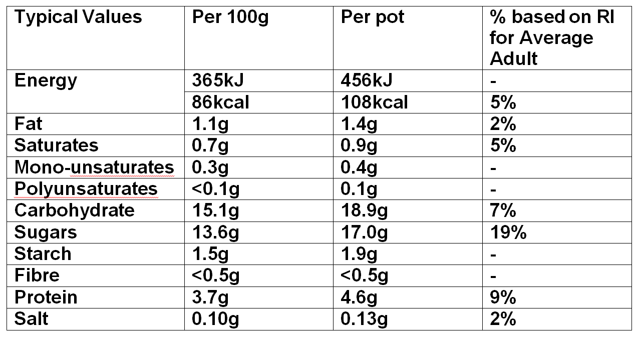
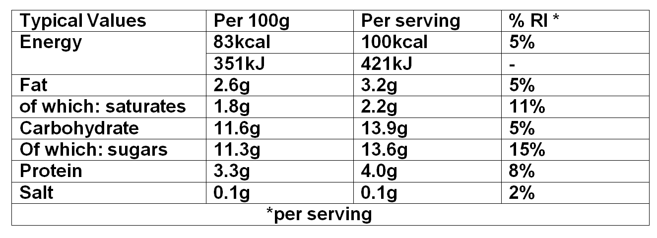
Per portion example – singel serve yoghurts
Notes:
Sainsbury’s own brand strawberry yoghrt vs Ski smooth strawberry and raspberry yoghurt

Slide 13
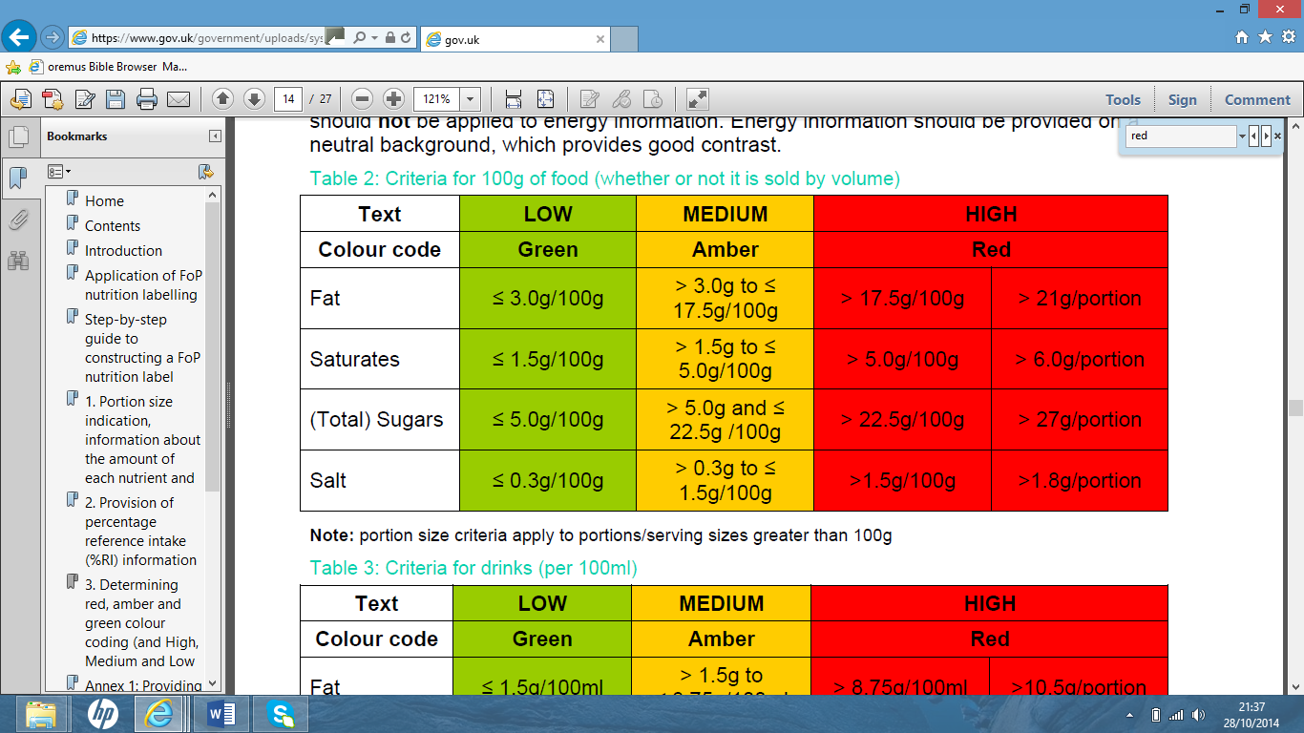
Sugar
Notes:
Practice with food labels – find low fat/sugar/salt
Highlight BHF booklet with credit card sized version of the above
NEXT SLIDE – key things learnt?
Guidance per 100ml for liquids
13

Slide 14
Using Low/Medium/High guide
Works well with processed foods to help us identify healthier versions
Does not mean that nutritious higher fat foods (e.g. nuts, oily fish, olive oil)
or unsweetened fruit have to be avoided

Slide 15
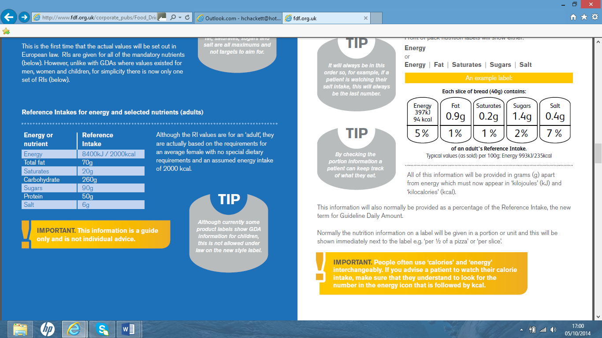
Reference Intakes (RIs)
Kcal | 2000
Fat | 70g
Saturates | 20g
Sugars | 90g
Salt | 6g
How much of each of the nutrients an
average person should have each day.
They are maximums rather than something
to aim for.
Notes:
RI
Explain % of ‘allowance’/recommended amount – maximum not something to aim for
For next slide: summary/key points
15

Slide 16
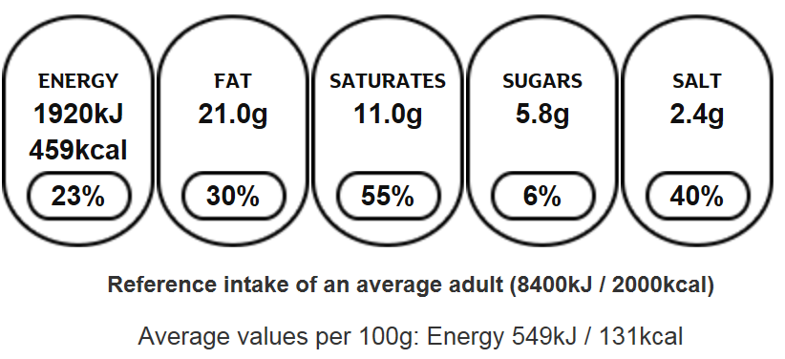
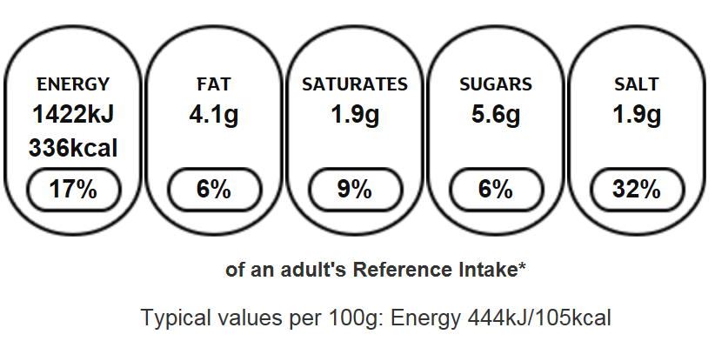
South Indian Chicken Curry 350g ready meal
Chicken Curry 320g ready meal

Slide 17
Using Reference Intake (RI)
RI = how much of each of the nutrients an average person should have each day.
They are maximums rather than something to aim for.
RIs are based on the ‘average’ woman having 2000 kcals /day – individuals may require more/less energy and therefore more/less of the nutrients.
The % shown on the front of pack labelling tells you what proportion of that ‘allowance’ a serving will ‘use up’.
Does not provide information on carbohydrate (need to check the nutrition information section for this).
Front of pack information is based on what manufacturer deems to be a portion and may be different to serving an individual may choose to consume.

Slide 18
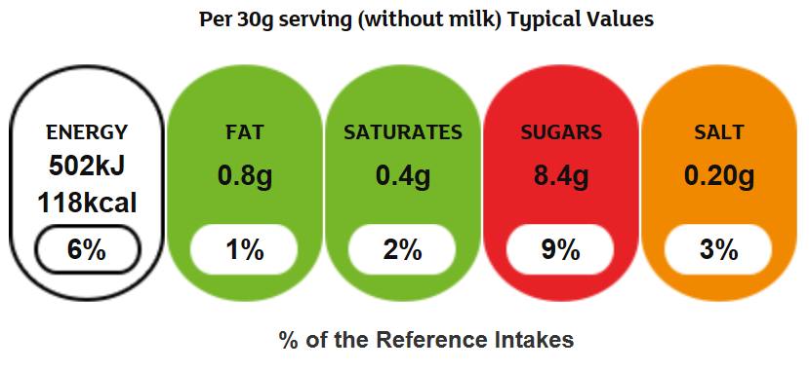
Traffic lights
Designed to help people, at a glance, quickly decide which foods are healthier.
Red – high (only as a treat), amber – medium (occasionally), green - low (go)
Notes:
Traffic light labelling
NB per portion
Natural sugar/fats = amber/red e.g. fruit, oily fish,
18

Slide 19
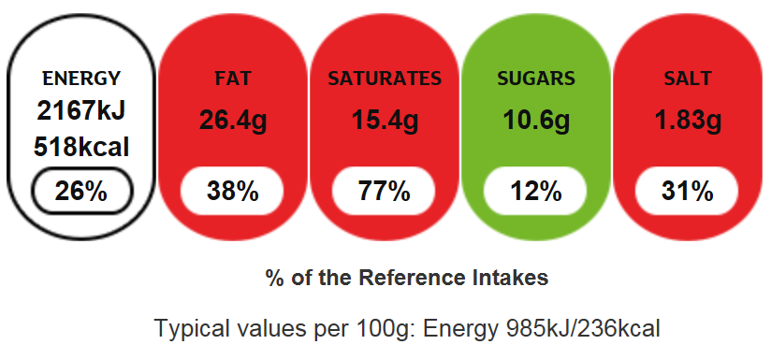
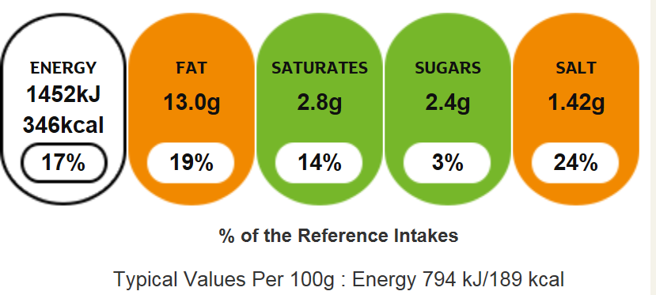
Red Leicester Ploughman's Sandwich
Egg & Cress Sandwich

Slide 20
Using Traffic Light Labelling
Does not provide information on carbohydrate (need to check the nutrition information section for this).
Does not mean that nutritious higher fat foods (e.g. nuts, oily fish, olive oil)
or unsweetened fruit have to be avoided.
Front of pack information is based on what manufacturer deems to be a portion and may be different to serving an individual may choose to consume.
Check the nutrition information for more details information on how much of each nutrient is in the food.

Slide 21
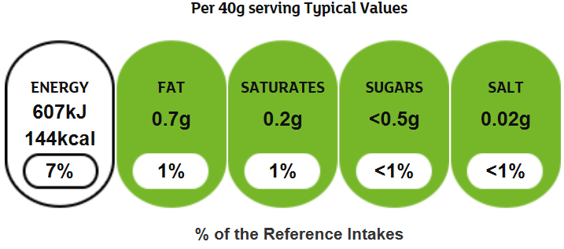
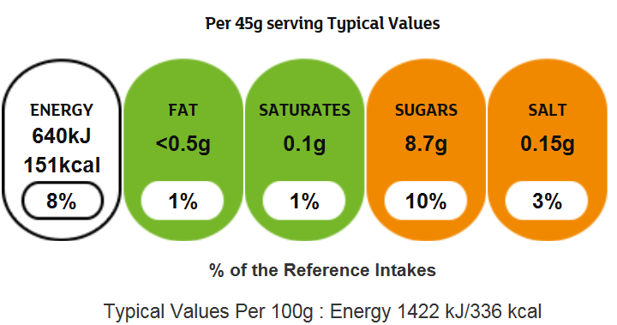
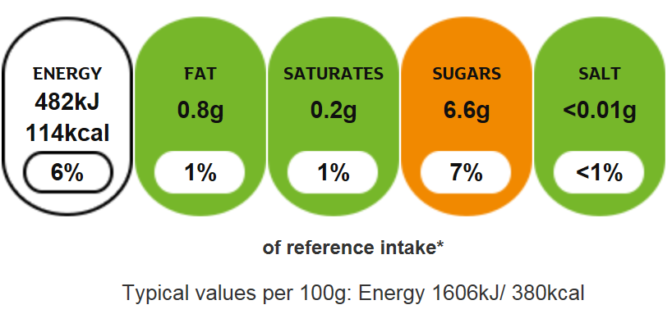
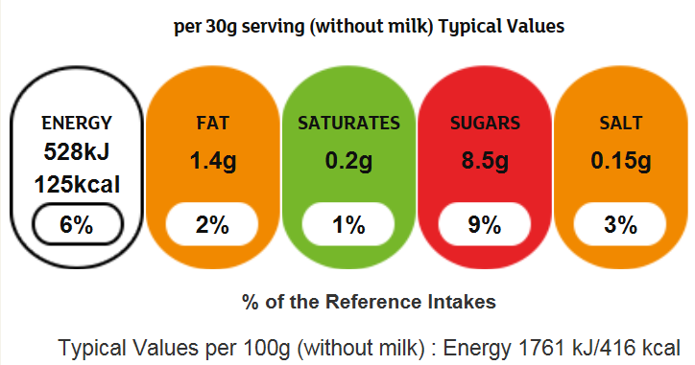
Mini wheats
Golden syrup wheats
Honey monster puffs
Honey nut cornflakes

Slide 22
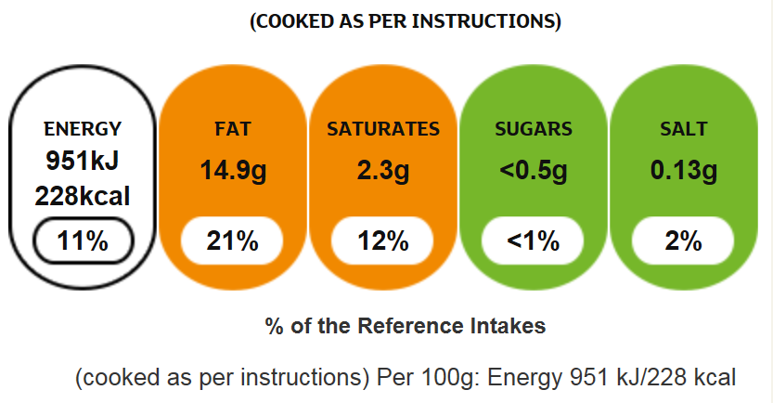
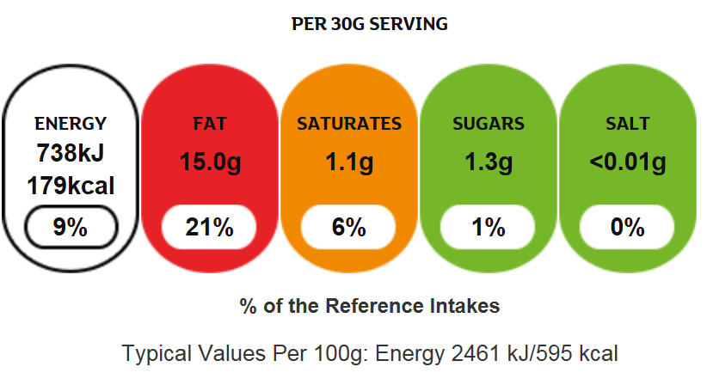
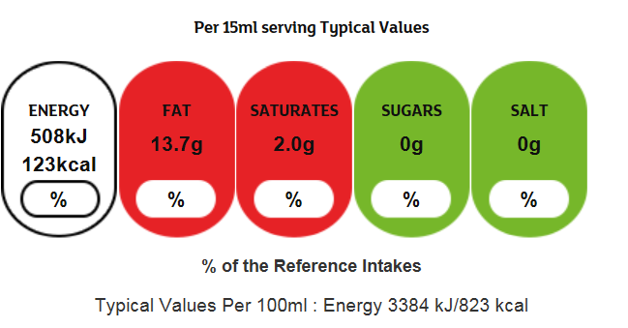
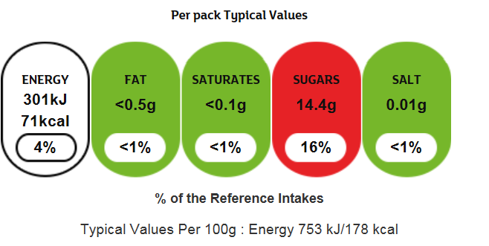
salmon fillet
almonds
extra virgin olive oil
dried apricots

Slide 23
Nutrition Claims
Sugar free
No sugar. May not be low calorie
Fat Free
No fat. May be higher in sugar.
Low Fat
3g or less of fat per 100g (3% or less). May be higher in sugar
Low Sugar
5g or less of sugar per 100g (5% or less).
Remember it is total carbohydrate, not just sugar,
that has an impact on blood glucose levels.
No added Sugar
No sugar is added. There may be naturally occurring sugar
Reduced Fat
Contains at least 30 per cent less fat than the standard version.
May not be low fat.
Reduced Sugar
Contains at least 30 per cent less sugar than the standard version.
May not be low sugar.

Slide 24
Thank you for joining us today!

