Slide 1
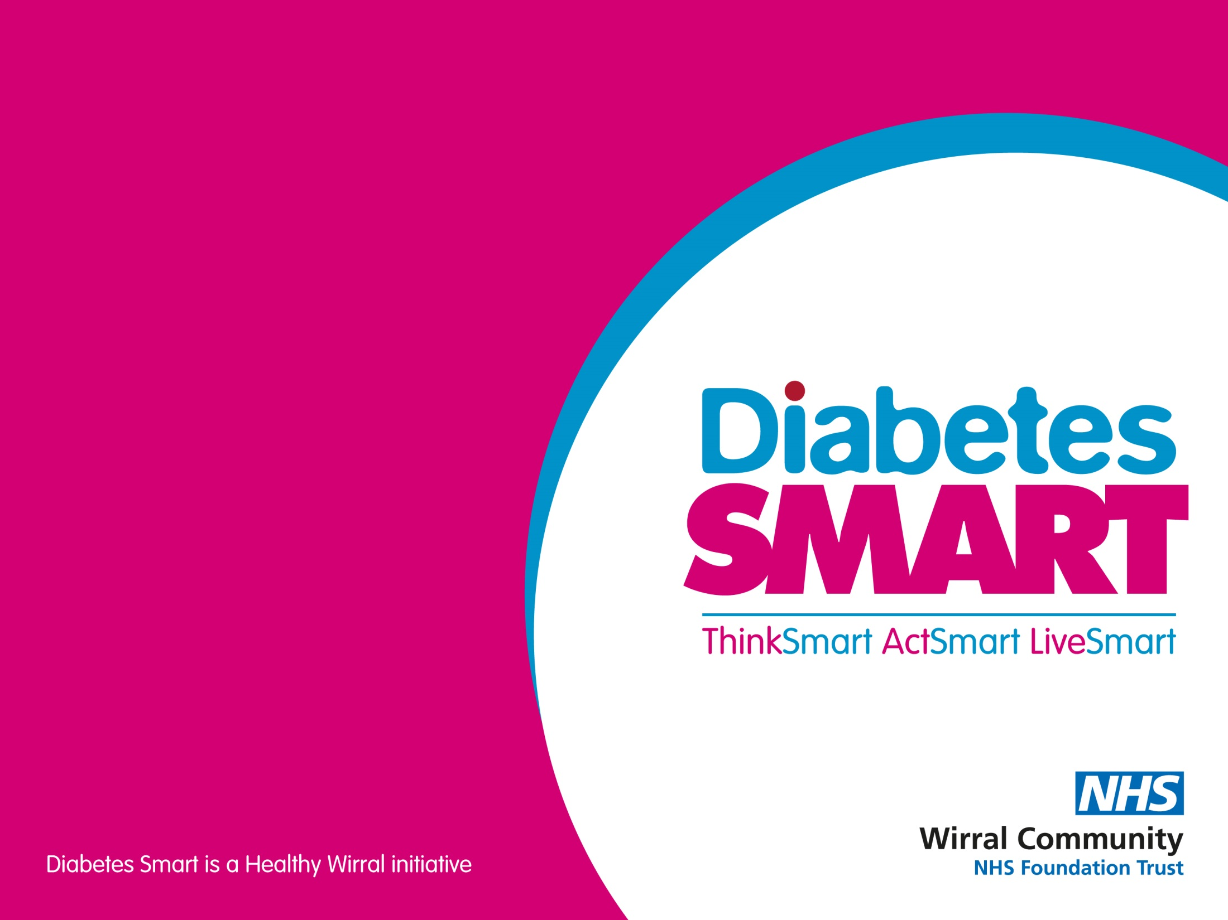
Physical Activity
– Hypoglycaemia
Presented by:
Helen Hackett
Advanced Dietitian

Slide 2
Hypos (low blood glucose levels)
Blood glucose levels below 4 mmol/l (with or without symptoms)
Effects can last for up to 24 hours
Should not be a risk for diet control/metformin treatment

Slide 3
Symptoms of hypos (low blood glucose levels)
Feeling shaky
Sweating
Hunger
Tiredness
Blurred vision
Lack of concentration
Headaches
Feeling tearful, stroppy or moody
Going pale

Slide 4
Possible causes of hypos (low blood glucose levels)
Unplanned physical activity
Not enough carbs
Delayed or missed meal or snack
Too much insulin/ diabetes medication
Heat
Injecting insulin in an area being used for exercise
Not rotating insulin injection site and developing ‘lipos’
Drinking large quantities of alcohol or alcohol without food

Slide 5
Hypo treatment
15–20g of fast-acting carbohydrate. Suitable treatments include:
Glucose tablets x 4 to 5
Sweets, such as jelly babies x 4
Pure fruit juice x 200ml-250ml
Glucose gel x 1-2 tubes
A sugary (non-diet) drink (>200ml) – check labels
Retest blood glucose levels after 15–20 minutes
and re-treat if blood glucose levels are still less than 4mmol/l.
Snack of 15–20g of slower-acting carbohydrate e.g.
A sandwich
Piece of fruit
Cereal
Some biscuits and milk

Slide 6
Preventing hypos
Take tablets and/or insulin injections correctly
Reduce insulin dose for planned activity
Avoid injecting insulin in the areas of the body about to be used in exercise
Don’t miss a meal.
Eat enough carbohydrate: take extra carbohydrate if more active than usual
Carry hypo treatment
Do not drink alcohol on an empty stomach or drink too much alcohol.

