Slide 1


Physical Activity
– Recommendations
Presented by:
Community Dietitian

Slide 2
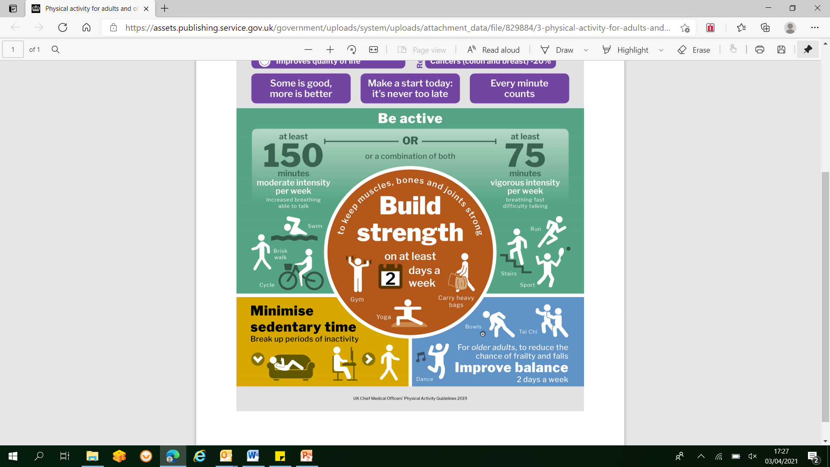
Activity recommendations

Slide 3



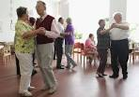
Moderate Intensity Activity
Breathing is increased (heavier/faster). Still able to talk/hum but not sing
Increase in heart rate
Feel warmer and may sweat on hot or humid days.
Aim for at least 150 minutes (2 and ½ hours) each week

Slide 4




Vigorous activity
Working really hard.
Breathing very hard/fast and have difficulty talking (only able to say a word or two)
Rapid heartbeat
Heavily perspiring
75 minutes per week or a combination of moderate and high intensity activity

Slide 5


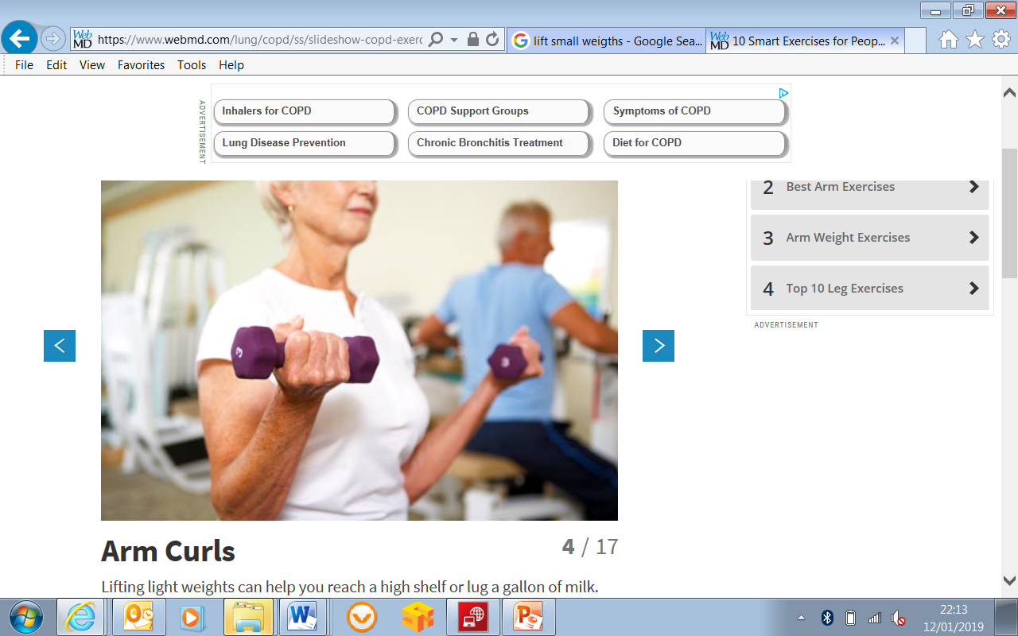

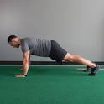


Activity to Improve Muscle Strength
At least 2 days a week
Training with weights (or body weight). Aim to work all major muscle groups (
Exercises should be performed to the point at which it would be difficult to do another repetition without help.

Slide 6
Physical Activity
Benefits can be achieved through sessions of 10 minutes or more.
Overall volume of physical activity is more important than frequency or duration.
Effects (blood glucose, calorie burning) last longer than time doing exercise itself.
Regular activity is important to sustain the benefits. Aim to be active every day,
at least spaced at no more than 48 hour intervals .

Slide 7
Reduce Time Spent Sitting
Sedentary behaviour is not just a lack of physical activity.
It is regularly doing things where you are sitting or lying and energy expenditure is very low.
Spending large amounts of time being sedentary may increase the risk of some health
problems.

