Slide 1
Annual Members’ Meeting 2020-21
Wednesday 10 November 2021

Slide 2
Agenda
  Welcome Professor Michael Brown - Chair
  Review of the year Karen Howell - Chief Executive
  Financial Review Mark Greatrex - Chief Finance Officer
  Quality Account Paula Simpson - Chief Nurse
  Report from the
  Council of Governors Alison Hughes - Director of Corporate Affairs
  Looking ahead Karen Howell – Chief Executive
  Questions & Answers Professor Michael Brown - Chair

Slide 3
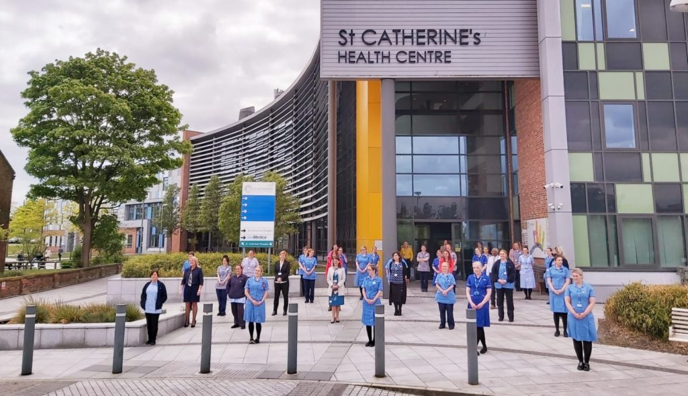
Review of the year
Karen Howell
Chief Executive

Slide 4
What some of our service users and their families have said about us…
“Lisa has been our assigned health visitor over the last 12 months or so. She has been incredibly supportive to my son and our family”.
0-19+ Health and Wellbeing Service, Cheshire East
“First class, professional, caring, compassionate service for which I am very grateful. Cannot praise it enough”.
Bladder and Bowel Service
"Care has been outstanding all the way through, listens well and is compassionate. Puts me at ease when anxious and helped me move forward. Help night and day.”
Community Intermediate Care Centre (Bluebell Ward)
“Amazing care and compassion, did more than was asked, over and above their remit, ultimate praise for Kathryn”.
Community Integrated Response Team - Rapid Community Response
“A massive thank you to Nurse Practitioner Dave and Student Nurse Cath at the Urgent Care Centre. Their kindness, humour and rapport skills were second to none - I can't praise them enough”.
Urgent Treatment Centre

Slide 5
Annual Review - responding to COVID-19
During 2020-21 the overwhelming need was for the Trust to respond effectively to the COVID-19 pandemic and national guidance issued for Community Services
The Trust delivered services under national ‘command and control’ arrangements
We continued to provide high quality, safe care to our local communities and we introduced new and innovative ways of working
We worked alongside the hospital and other health and social care partners to actively support the system to respond to the pandemic
  Our Integrated Discharge Team (IDT) worked with the hospital to affect the requirements of national guidance on effective discharges
  Our specialist Infection Prevention and Control Team provided in-reach support to care homes across Wirral, to improve infection prevention and control standards, and improve response to outbreaks of COVID-19
Notes:
The pandemic placed a great focus on developing capacity in intermediate care and rapid response provision, building telehealth provision to keep people safe whilst reducing impact on secondary care services, supporting COVID testing, and infection control in all settings and especially in care homes.
The Trust played a significant role both strategically and operationally in this response.

Slide 6
Annual Review - ensuring a coordinated response
We engaged with our partners to ensure a coordinated response to health and
care services
We supported our workforce to ensure they were able to look after themselves, each other and our patients and service users
In the last quarter of 2020-21 we opened the Community Intermediate Care Centre, our first inpatient wards providing rehabilitation and reablement support to people following discharge from the hospital

Slide 7
Annual Review - ensuring equity of delivery and access
In responding to the challenges of the pandemic, all system partners acknowledged individual and collective legal duties under the Equality Act 2010
NHS services were delivered in alternative ways
We focused on ensuring our services were accessible to all groups
All services conducted an Equality Impact Assessment (EIA)
We continued to provide the most important services to those who needed them most by establishing alternative modes of delivery to ensure there was still a service available

Slide 8
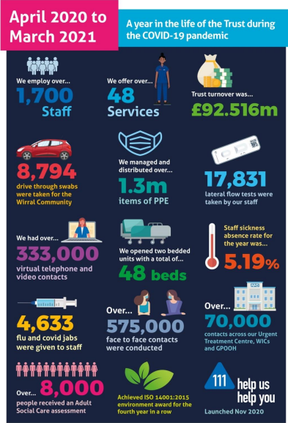
Our services delivered over 1 million contacts
Despite the challenges of the pandemic over 575,500 of these contacts were face to face with our staff supported with all the appropriate PPE to deliver care safely
We also developed new services for our communities including;
  A COVID ‘virtual ward’ in the community
  Tele-health monitoring and the Oximetry @Home service
  Hospital @Home service
  COVID-19 testing services
  COVID-19 vaccination programme
  Supporting emergency bed provision
Notes:
We developed significant services for our communities to support their health and wellbeing during the pandemic, and developments during 2020-21 include;
Integrated community pathways including four new ‘discharge from hospital’ pathways
A COVID ‘virtual ward’ in the community
Tele health monitoring for people with exacerbations and deterioration of COPD and heart failure, and the establishment of the Oximetry @Home service
Hospital @ Home pilot in partnership with the local hospital trust
Opening of the Community Intermediate Care Centre • Enhanced palliative and end of life pathways
Enhanced Infection, Prevention and Control support to care homes Wirral Community Health & Care NHS Foundation Trust Annual Report and Accounts 2020-2021 14
NHS 111 - transforming the way patients access urgent and emergency care by offering a single point of access, standardised assessment, clinical validation and onward direct referral to ED or other alternative services
Supporting emergency bed provision – the Trust provided enhanced MultiDisciplinary Team wrap around across the emergency bed base to support flow through the community and emergency bed bases.
Established and delivered two new COVID-19 testing services and supported the system vaccination programme
Achieved the ISO 14001-2015 Environmental Award
Engagement with our governors and members (through the Your Voice group) remained during the pandemic to provide regular updates on the Trust’s response

Slide 9
Annual Review - recognition through awards
Our expertise and care was recognised in a number of regional and national awards including;
  Level 2 Future-Focused Finance Towards Excellence Accreditation
  The Queen’s Nursing Institute awarded the Philip Goodeve-Docker Memorial Prize 2020 to a Senior Nurse Practitioner
  The Infection Prevention Society recognised the Infection Prevention and Control Team as their ‘Team of the Year’
And… we were shortlisted for the HSJ Patient Safety Awards in two categories
  The Integrated Therapy Review initiative for ‘Improving Care for Children and Young People Initiative of the Year’
  The IPC Care Home Project for the ‘COVID-19 Infection Prevention and Control Award’

Slide 10
Annual Review - system working
Through 2020-21, the development of the Integrated Care System (ICS) model continued
  The Cheshire and Merseyside system (which will be the ICS in which all of the Trust’s services will be delivered when it becomes a statutory body in April 2022) acted as an important level of coordination for the pandemic response
We continued to be a significant partner in the health and care systems of Wirral and Cheshire East
We were awarded the contract for 0-19 services in St Helens which commenced in September 2021
Notes:
0-19 services in St Helens - This reflects our strategic aim of providing services where we are best placed to do so and improve the offer for residents within Cheshire and Merseyside.

Slide 11
Annual Review - supporting and listening to our staff
Our staff are our greatest resource and support to staff to keep them safe during the pandemic was a priority, and included;
Individual risk assessments
Personal Protective Equipment (PPE)
Access to regular lateral flow testing
Wellbeing advice and support
Enhanced daily communication bulletins
Weekly vlogs by senior leaders
Pulse surveys (including the national NHS People Pulse)
We were also delighted to hold a virtual Staff Awards in summer 2020 which provided an opportunity to recognise and celebrate the hard work of our staff.
Notes:
Our first pulse survey received over 800 responses providing us with useful intelligence and feedback
Over 75% of respondents reported feeling motivated or very motivated
62% of respondents felt connected or very connected to their team
70% of respondents reported feeling confident in the Trust’s response to PPE

Slide 12

Annual Review - developing our Trust values
We launched the Shaping Our Future programme in late 2020 to develop the values of our organisation with our staff
All staff were asked to contribute via an on-line survey and get involved through focus groups
We launched our new values to coincide with the 10th birthday of the Trust in April 2021

Slide 13


Slide 14
Health and Care Bill 2021
The Health and Care Bill, introduced into the House of Commons in July 2021 is intended to dismantle many of the structures established by the Health and Social Care Act 2012
The proposed Bill implements NHS England’s recommendations to support integration by legislating for every part of England to be covered by an Integrated Care Board (ICB) and Integrated Care Partnership (ICP)
newbook.book (parliament.uk)

Slide 15
What delegations are enabled by the Health and Care Bill?
The Health and Care Bill will give Integrated Care Boards (ICB) statutory powers, functions and duties including (subject to the passage of legislation through parliament):
The ability to delegate to a committee or sub-committee of the ICB board, or to an individual board member or employee
The power to agree with trusts and/or local authorities that they will exercise functions on behalf of the ICB or jointly with the ICB. This new power will be governed by secondary legislation and NHSE/I statutory guidance (both expected in March 2022)
The ICB board, regardless of any delegation arrangements it has made, remains legally accountable for the exercise of its functions.

Slide 16

Finance review
Mark Greatrex
Chief Financial Officer/Deputy Chief
Executive

Slide 17
Finance Review
The Trust met all its statutory financial duties for 2020/21 – financial planning/performance processes suspended nationally due to COVID-19
Financial performance was strong – with a breakeven position required to September 2020 and exceeded the plan for the rest of the year by £110k
Opened the Community Intermediate Care Centre in January 2021, providing the Trust’s first inpatient wards
£626k of recurrent savings achieved despite the suspension of CIP targets
Spent £5.0m on capital assets/infrastructure investment
Received income of £92.5m for delivering healthcare services

Slide 18
Where does our funding come from?
Received £92.5m for delivering healthcare for the year

Slide 19
How do we spend our funding?
Spent £93.1m in the delivery of our services to our populations

Slide 20
Capital spend for the whole year
Capital spend of £5.0m on:
  £2.7m - Information Management and Technology, including endpoint device replacement, infrastructure and network investment
  £2.1m - Estate refurbishment and works, including Marine Lake Development and generator replacement at St Catherine’s Health Centre
  £0.2m - Medical equipment and Corporate schemes, including dental upgrades and E-Rostering

Slide 21
Our financial future
Significant challenges in the wider health economy - reset and restore activity for non-COVID care, alongside continuing readiness for winter and a potential further increase in COVID-19 cases
Remaining financially stable with the Trust reporting a breakeven position to September 2021 in accordance with national guidance
Uncertainty regarding the financial allocations for 2022/23
Ability to recruit
Identifying recurrent efficiencies
Major capital programme in progress to develop new health facilities in Marine Lake, West Kirby due to complete in 2022/23

Slide 22
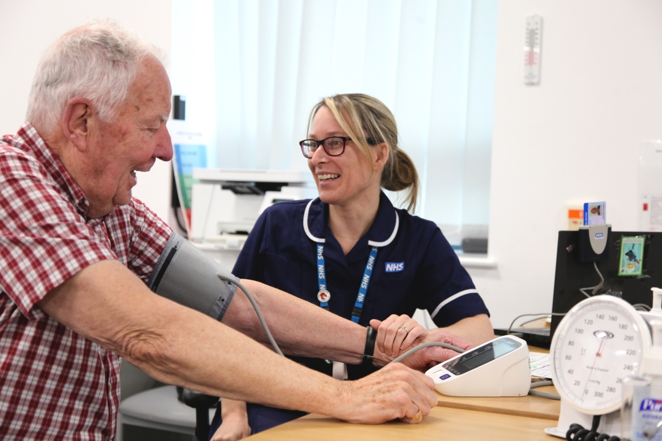
Quality Account
Paula Simpson
Chief Nurse and Director of
Infection Prevention and Control

Slide 23
Quality Account
Quality Reports are annual reports that all providers of NHS services in England have a statutory duty to produce
Due to COVID-19, NHS Foundation Trusts are not required to include a quality report in their annual report for 2020/21
Primary legislation continues to require providers of NHS services to prepare a Quality Account
It was NOT a requirement to obtain external stakeholder reports this year, however, we invited partners to offer feedback which is included within the Quality Account
Notes:
The Quality Report must contain:
Statement on quality from the chief executive
Priorities for improvement and statements of assurance from the board
Other key indicators information and two annexes:
statements from NHS England/relevant clinical commissioning
groups, local Healthwatch organisations, and overview and
scrutiny committees
a statement of directors’ responsibilities
for the quality report
While, the amended regulations mean there is no fixed deadline by which providers must publish their 2019/20 quality account.
We recommend for NHS providers that a revised deadline of 15 December 2020 would be appropriate, in light of pressures caused by COVID-19.
NHS providers are no longer expected to obtain assurance from their external auditor on their quality account / quality report for 2019/20.

Slide 24
Quality Account
Annually, the Trust identifies three quality goals aligned to the
recognised pillars of quality:
Safety
Experience
Effectiveness

Slide 25
Maintaining safety during COVID-19
Safety has remained our paramount priority for our service users and workforce (clinical, professional and non clinical)
Our strong quality governance framework has remained in place throughout and been enhanced through increased monitoring of compliance with new national guidance
CQC review of IPC standards was positive - with good assurance noted

Slide 26
Safety
Development of clear Infection Prevention and Control guidance for staff
  Regular review of guidance
  zero nosocomial infections across our services
Psychological safety of staff
  introduction of debrief conversations
  Daily Covid Bulletin
Continued focus of learning from incidents
  System wide reviews and shared learning
  Zero never events
Notes:
IPC guidance – At the beginning of the Covid-19 pandemic in 2020, the Health and Safety Executive (HSE) and Public Health England (PHE) produced recommendations for the Covid-: Infection Prevention and Control guidance in health care settings. The Trust implemented all the legislative guidance to keep staff, patients, service users and members of the public safe when using our premises or attending essential face to face consultations.
Debrief conversations - Staff can request a debrief conversation via the Trust Incident Reporting System to support staff affected by patient safety incidents and allows time to share thoughts and feelings and help build emotional resilience as a team. This is not a self-indulgent activity, but essential to maintain the psychological safety and just and learning culture within the organisation.

Slide 27
Experience
‘Your Voice’ group continued to meet virtually
  shared an understanding of common issues affecting local people
  member of the Wirral Older People’s Parliament joined the group
  service user input into improvement projects or to test ideas about changing services
Our Young Person participation and experience group ‘INVOLVE’ remained active

Slide 28
Clinical Effectiveness
Service Innovation
Launched our Beyond Boundaries campaign
  Pulse Oximetry Service
  Home Swabbing and Testing Centre
  Opening of Community Intermediate Care Centre (CICC)
Use of Digital Platforms in response to Covid-19
  virtual consultations via the Attend Anywhere and AccuRX platforms
  Adoption of Zoom for Business to support virtual consultations for speech and language therapy teams
  Rollout of Microsoft Teams (MS) to enable staff to work at home
Notes:
Pulse oximetry at home
We started monitoring patients with Heart Failure and Chronic Obstructive Pulmonary Disease (COPD) using a digital platform and patient reported observations in September 2020. A small team of 2 nurses’ supported patients with long term conditions to understand their symptom profile. Empowering them to self-manage their condition effectively and improving quality of life. Benefits for health and social care include: reducing the risk of unplanned hospital admissions, slowing down disease progression and a more engaged health population.In October 2020, we were asked to shift focus and support patients with Covid 19, monitoring their oxygen levels. Identifying the potentially fatal ‘silent hypoxia’ admitting these patients to hospital to receive lifesaving care and treatment, the earlier the better to increase their chances of survival and reduce ongoing complications.
Home Swabbing and Testing Centre
Home swabbing went live in April 2020 and the service was set up with 3 teams of 2 staff, 1 staff member to do the swabbing and 1 assistant, 7 days per week. The service was staffed with reassigned staff and 3rd year student nurses who were recruited in line with Covid support at the time. The service provided swabs to care homes and key workers who were not able to attend the satellite centre.
The satellite testing centre went live in May 2020. It was staffed with reassigned staff from the 0 – 19 service, Dental and other services. Again student nurses were recruited in line with Covid support at the time. The satellite testing centre ran 7 days per week until the end of September 2020.
CICC
The CICC is an exciting new development for the Trust, providing high quality, integrated care for the local adult population, supporting them with their reablement and self-care and encouraging them to reach their optimum level of independence. CICC opened on Monday 4 January 2021 consisting of Bluebell Ward, followed the following month with Iris Ward.
The unit now has three wards open and feedback from people who have accessed the unit is very positive.
Digital Platforms
As the Trust reacted to the Covid-19 pandemic, we became increasingly reliant on technology to support staff to work from home or work in different ways. The Information Technology (IT) team worked relentlessly to ensure we had safe and effective systems in place which included:
• Provision of additional computing endpoints to support front line staff / remote working
• Provision of mobile phones / data sim cards to support remote working
• Rollout of Microsoft Teams (MS) as the solution for video conferencing / virtual meetings enabling staff to work at home
• Adoption of Zoom for Business to meet specific use cases / virtual consultations for speech and language therapy teams
• Adoption of Attend Anywhere and AccuRX for virtual consultations and communication with patients reducing the need for face-to-face appointments in a clinic or care home
• System design, build and configuration of clinical workflows within the Trusts EPR system to support the Community Intermediate Care Centre / Step down wards at Clatterbridge
• Provision of enabling digital works for the Covid-19 vaccination centre at St Catherine’s Health Centre (this was not needed in the end but the work involved was considerable)

Slide 29
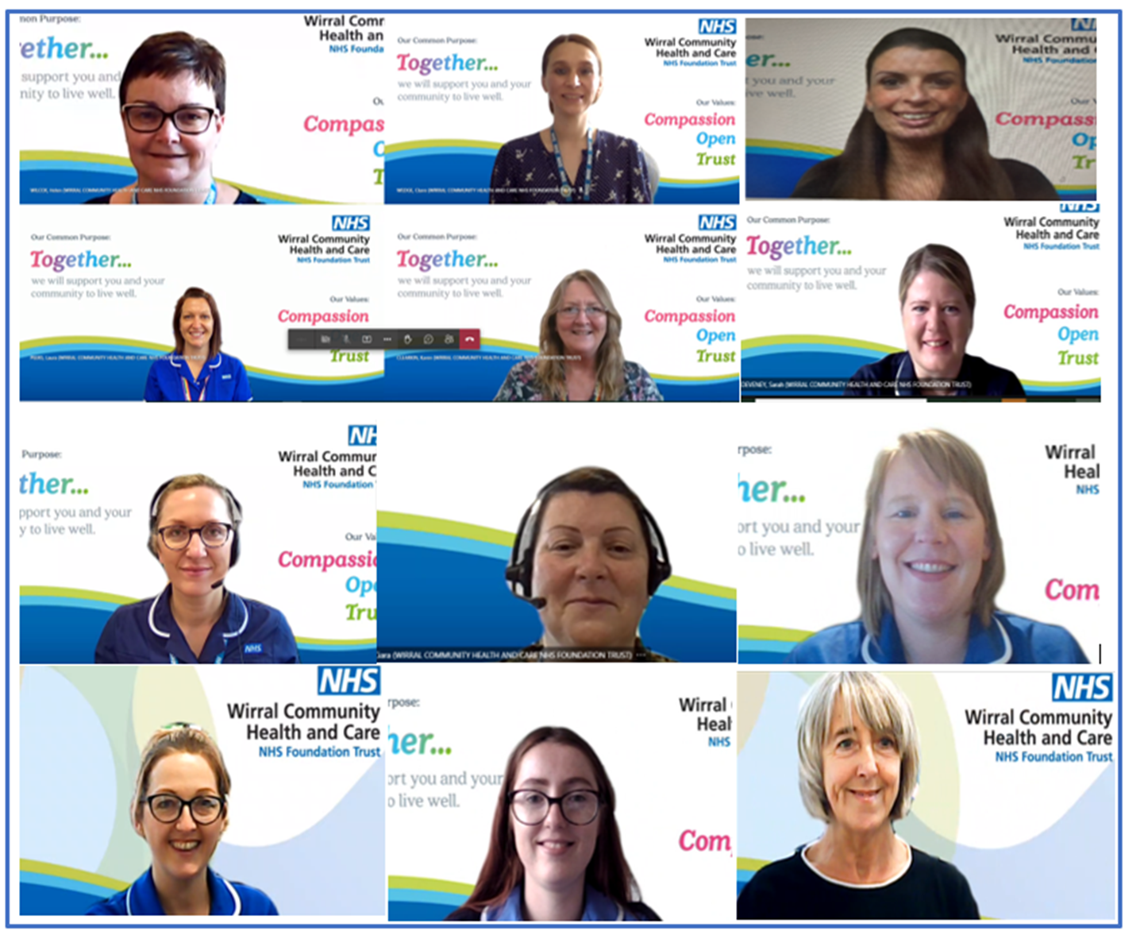
Infection Prevention Society Team of the Year 2021
IPC Care Home Project
Supported 125 Wirral care homes in partnership with Wirral Council
Implemented an IPC standards assurance framework (SAFE) supported by a dedicated team of IPC project nurses
Care home knowledge, skills, confidence and assurance around best practice for IPC increased
Commitment to working as a system bringing about better and shared outcomes for care home residents
True insight into the needs of care homes - supported by regular digital engagement
Notes:
Care homes were trained to use SAFE, complete regular monthly checklists - PPE, manager checklist and hand hygiene, quarterly environmental audits and yearly policy checklist
Flexible approach to training based upon local intelligence, system priorities, changes in national and local guidance, system learning and identification of key themes

Slide 30
QUALITY PLAN 2021-22 Supporting our populations to thrive through a preventative, personalised, holistic and integrated approach with the person at the heart of every conversation and decision working with system partners to optimise wellbeing and independence
Engaged populations | Effective and innovative | Safe care & support every time
We will involve people as active partners in their wellbeing and safety, promoting independence and choice by … Embedding a more inclusive approach which promotes the rights, strengths, expertise and wellbeing of people, families and communities We will support this by … Delivering an enhanced engagement plan with people accessing our services Building engagement skills across all services Positioning ‘what matters to me’ and co-production as a core feature of personalised care & support planning and continuous quality improvement Developing appropriate services by actively seeking insight into the needs of our populations | We will nurture an improvement culture focused on consistently delivering effective, efficient care and support by … Trusting, liberating and empowering staff to innovate and test new ideas We will support this by … Adopting a clear QI methodology which is easy to understand, implement and measure Establishing a QI faculty to coordinate training and development of staff in line with agreed competencies framework Building a system to track QI projects across the organisation Hosting celebration and sharing events throughout the year | We will nurture a positive safety culture, promoting psychological safety and supporting reflection by … Focusing on identified safety priorities (falls prevention and safe discharge) and launching our Just and Learning Culture campaign We will support this by …. Implementing Team Time and Schwarz Rounds Building the skills of identified safety specialists Strengthening our system of disseminating learning across the organisation Further embedding CRMG, SAFE and Datix as key systems for assuring safety across health and social care
POPULATION HEALTH FOCUS Building back fairer – focus on inclusion and tacking inequalities at an organisational and system level Appropriate access to care and support – expanding the benefits of digital inclusion Coalition of safety and improvement across system – leading the way in keeping people safe and well
Notes:
Statement at the top reflects our evolution as an organisation and recognises the benefits that integration brings us in the way we support people. It is a clear statement about how the person is at the heart of every conversation and decision and signals an intent to work closely with system partners with the aim of optimising wellbeing and independence.
As always, the plan is split into three sections, engaged populations, effective and innovative and safe care and support
The first priority describes our intention to enhance our engagement approach with people and outlines how we will actively seek insight into the neds of our populations and develop services accordingly.
Effective and innovative will be focussed this year on building quality improvement skills across our services embedding this as the way we do things and trusting and liberating staff to act
Within safe care and support, we will as always focus on key safety priorities – this we falls prevention and safe discharge, we will develop safety experts in response to the national patient safety strategy and we will work hard to continue creating a safe environment where staff feel comfortable and confident to report errors in order to continuously learn and improve.
The final section then talks about our future approach which will be focussed on reducing inequalities, appropriately utilising digital technology to enhance care and self care and describes the development of a coalition of safety across the system – working together to keep people safe and well

Slide 31
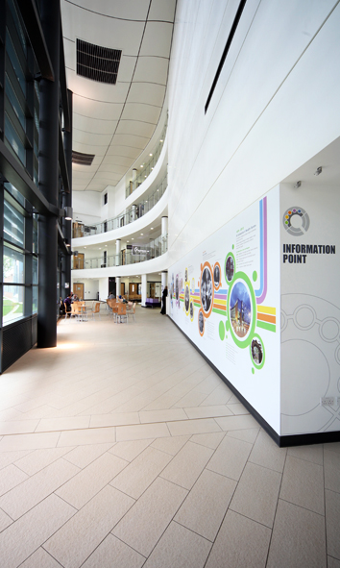
Report from the Council
of Governors
Alison Hughes
Director of Corporate Affairs
Notes:
The Trust continues to have a strong and representative membership through 7,835 members, both public and staff. During 2018-19 the Trust continued to recruit young members through initiatives with local schools and the ‘Young Chamber’ in Wirral and saw a positive impact on membership numbers with over 1,000 young members (aged 16-21 years) signed up to the Trust. The public membership in the Rest of England constituency remains a priority for the Trust with a detailed action plan already in place.
The Council of Governors is keen to identify opportunities to engage with members and during 2018-19, the ‘Your Voice’ group continued to meet but with an expanded membership to include governors and more members. This group continues to evolve but has provided useful feedback and reflections on the meaning of membership to support a refresh of the Trust’s membership strategy.
During 2018-19 the Council of Governors participated in walkrounds and service visits with Non-Executive Directors providing another opportunity to engage with Trust members and service users. Our governors are also invited to numerous events during the financial year to support a greater understanding of the Trust and to further develop and strengthen relationships. We are always delighted to have governors participate in judging the annual HEART Awards and value the perspective and enthusiasm they bring to this process.
The Trust is committed to improving the health and wellbeing of patients and staff, ensuring it contributes positively to the lives of the local communities.
This was illustrated in 2018-19 with some of the following key activities;
The Trust continues to have a strong and representative membership through 7,835 members, both public and staff. During 2018-19 the Trust continued to recruit young members through initiatives with local schools and the ‘Young Chamber’ in Wirral and saw a positive impact on membership numbers with over 1,000 young members (aged 16-21 years) signed up to the Trust. The public membership in the Rest of England constituency remains a priority for the Trust with a detailed action plan already in place.
The Council of Governors is keen to identify opportunities to engage with members and during 2018-19, the ‘Your Voice’ group continued to meet but with an expanded membership to include governors and more members. This group continues to evolve but has provided useful feedback and reflections on the meaning of membership to support a refresh of the Trust’s membership strategy.
During 2018-19 the Council of Governors participated in walkrounds and service visits with Non-Executive Directors providing another opportunity to engage with Trust members and service users. Our governors are also invited to numerous events during the financial year to support a greater understanding of the Trust and to further develop and strengthen relationships. We are always delighted to have governors participate in judging the annual HEART Awards and value the perspective and enthusiasm they bring to this process.
The Trust is committed to improving the health and wellbeing of patients and staff, ensuring it contributes positively to the lives of the local communities.
This was illustrated in 2018-19 with some of the following key activities;

Slide 32
Public Governors 2020-2021
Birkenhead
Irene Cooke
Fahim Syed
Ian Jones
Wallasey
Bill Wyllie (Lead Governor)
Gary Hartley-Kelly
Vacancy
Rest of England
Jan Gidman
Wirral South and Neston
Kevin Sharkey (Deputy Lead Governor)
Veronica Cuthbert
Wirral West
Lynn Collins (Deputy Lead Governor)
Veronica Morris

Slide 33
Staff and Appointed Governors 2020-21
Staff
Fiona Davies, Speech and Language Therapy
George Taylor, MSK Physiotherapy
Jan Hegarty, Adult Social Care
Appointed Governors
Eve Collins, University of Chester
Paul Edwards, Director of Corporate Affairs, Wirral CCG
Karen Prior, Healthwatch Wirral Manager
Brian Simpson, Magenta Living
Julie Webster, Wirral Borough Council
X1 vacancy

Slide 34
The Council of Governors
We held elections in autumn 2020 with 2 public governor seats and 1 staff governor seat up for re-election
We were delighted to welcome;
  Gary Hartley-Kelly, public governor, Wallasey
  Lynn Collins, public governor, Wirral West (re-elected)
  Jan Hegarty, staff governor, Adult Social Care
We extend our thanks to Dr Paul Ivan, whose term of office ended in 2020 and to Sharon Cringle who resigned from the CoG due to other commitments
Notes:
The Trust has kept in regular contact with governors throughout the COVID-19 health emergency. Council of Governors meetings have continued during the pandemic.

Slide 35
CoG business during 2020-21
The Council of Governors met formally on 4 occasions and held 4 informal development days
  Emergency governance arrangements
  COVID-19 response and operational service delivery
  Performance overview and service restoration plans
  Shaping Our Future - values workshops and briefings on strategic workplan
  Well-Led development review briefing and update
  Plans for the resetting of governance arrangements
  CQC briefings and updates
  Participated in the judging day for the virtual Heart Awards

Slide 36
CoG business during 2020-21
The Remuneration & Nomination subgroup of the CoG considered and recommended the re-appointment of the Chair and one Non-Executive Director (to September 2023); this was subsequently approved by the full CoG in January 2021
The group also approved revisions to Non-Executive Directors remuneration (excluding the Chairman) in line with the “Structure to align remuneration for chairs and non-executive directors of NHS trusts and NHS foundation trusts” issued in November 2019.
The Governor Quality Forum was temporarily suspended during 2020-21, however the Chair of the forum met with the Chair of the Trust’s Quality & Safety Committee (following each meeting of the committee) to receive a briefing on quality and safety priorities and performance across the Trust.

Slide 37
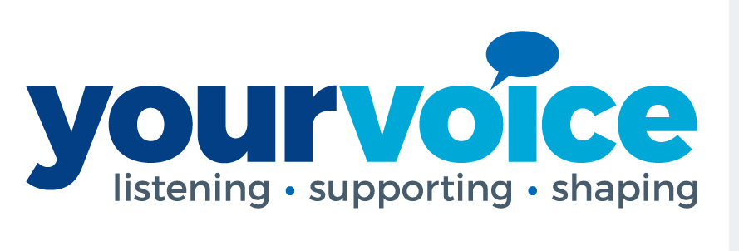
Membership
At the end of 2019-20 the Trust had 7,778 members
  6,092 public members
  1,716 staff members
Our membership is representative of our local population
  Close to 1,000 young members (aged 16-21 years)
The ‘Your Voice’ Group provides a forum for our members and governors to engage with the Trust and each other to share the views of the public and to;
  improve the experiences of people receiving care from the Trust
  input and share views on service redesign and key projects
  review and discuss Trust related data/intelligence
  support the development of new quality goals for the organisation
  support the development and implementation of an effective Trust Membership Strategy

Slide 38
Council of Governor Election - dates
Action | Date
Last Day for Publication of Notice of Election | 04/10/2021
Deadline for receipt of nominations | 01/11/2021
Publication of Statement of Nominations | 02/11/2021
Deadline for candidate withdrawals | 04/11/2021
Notice of Poll/Issue of ballot packs | 19/11/2021
Close of Poll 5.00pm | 10/12/2021
Count and Declaration of Result | 13/12/2021

Slide 39
Council of Governor Election - available seats
Constituency | Seats
Birkenhead | 2
South Wirral/Neston | 1
Staff | 1
Wallasey | 2

Slide 40
How to contact your governors?
The Council of Governors is supported by the Director of Corporate Affairs
You can contact any public or staff governor via the trust’s corporate office
on 0151 651 3939 or via a contact form on our public website
https://www.wchc.nhs.uk/about/board-governors/contacting-our-public-governors/
All governors also attend many of the Trust’s events and look forward to
meeting with and speaking to members
Don’t forget the Trust Board of Directors meets in public bi-monthly and all
agendas and papers are published on our website

Slide 41

Looking ahead
Karen Howell
Chief Executive

Slide 42
Looking ahead
The coming year will bring great challenges and opportunities to work differently
Our first challenge is simply the recovery from COVID-19
We will build on the use of digital technology and agile ways of working
We will continue our strong focus on Quality Improvement
We will be reshaping our locality teams to integrate with Primary Care Networks
We will be working with staff, partners and our local community to define our strategy for the next 5 years
We will be actively contributing to the development of the ICS and the ICP across the communities we serve
We will continue to listen and engage with our staff

Slide 43
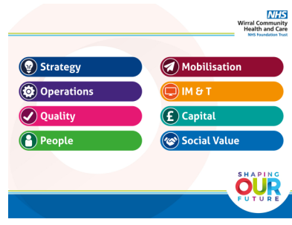
Looking ahead - our workplan for 2021-22
Our workplan sets out how we will reset service delivery building on innovations and efficiencies that arose from the response to the pandemic
The workplan has been shared across the Trust with each service developing their own Plans on a Page
Notes:
The work plan covers eight distinct areas:
Strategy
Operations
Quality
People
Mobilisation
IM&T
Capital
Social Value
For each of these areas the Trust has set out clear tasks and aims, and the process by which assurance and governance will be delivered, and the timescales for the completion of the tasks.
The work plan has been extensively shared across the Trust, with videos by the Chief Executive, information in The Update, briefings for managers and the presentation including all of the resources in the work plan is available on the StaffZone. Each team has looked at the work plan and developed their own team Plan on a Page, setting out how their work will contribute to the delivery of the Trust’s overall work plan for 2020-21

Slide 44

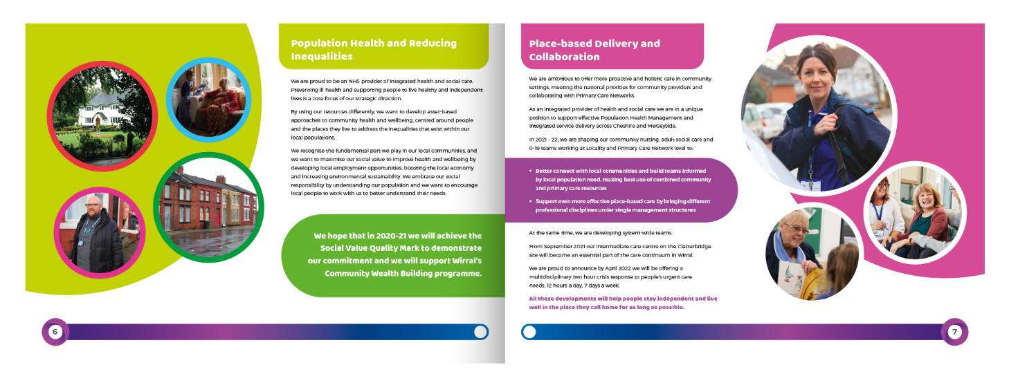
Looking ahead - Shaping our Future
We want your help to shape the future of our Trust and contribute to our future plans
The role of community health and care services has never been more important
Your feedback will support us in achieving our common purpose
Read our Shaping Our Future invitation and complete the survey
Notes:
The work plan covers eight distinct areas:
Strategy
Operations
Quality
People
Mobilisation
IM&T
Capital
Social Value
For each of these areas the Trust has set out clear tasks and aims, and the process by which assurance and governance will be delivered, and the timescales for the completion of the tasks.
The work plan has been extensively shared across the Trust, with videos by the Chief Executive, information in The Update, briefings for managers and the presentation including all of the resources in the work plan is available on the StaffZone. Each team has looked at the work plan and developed their own team Plan on a Page, setting out how their work will contribute to the delivery of the Trust’s overall work plan for 2020-21

Slide 45
Questions & Answers
  We invited you to submit questions in advance of the meeting and any received will be responded to by the relevant Director.
  All questions will be responded to with the answers published on our
  website - wchc.nhs.uk

