Slide 1
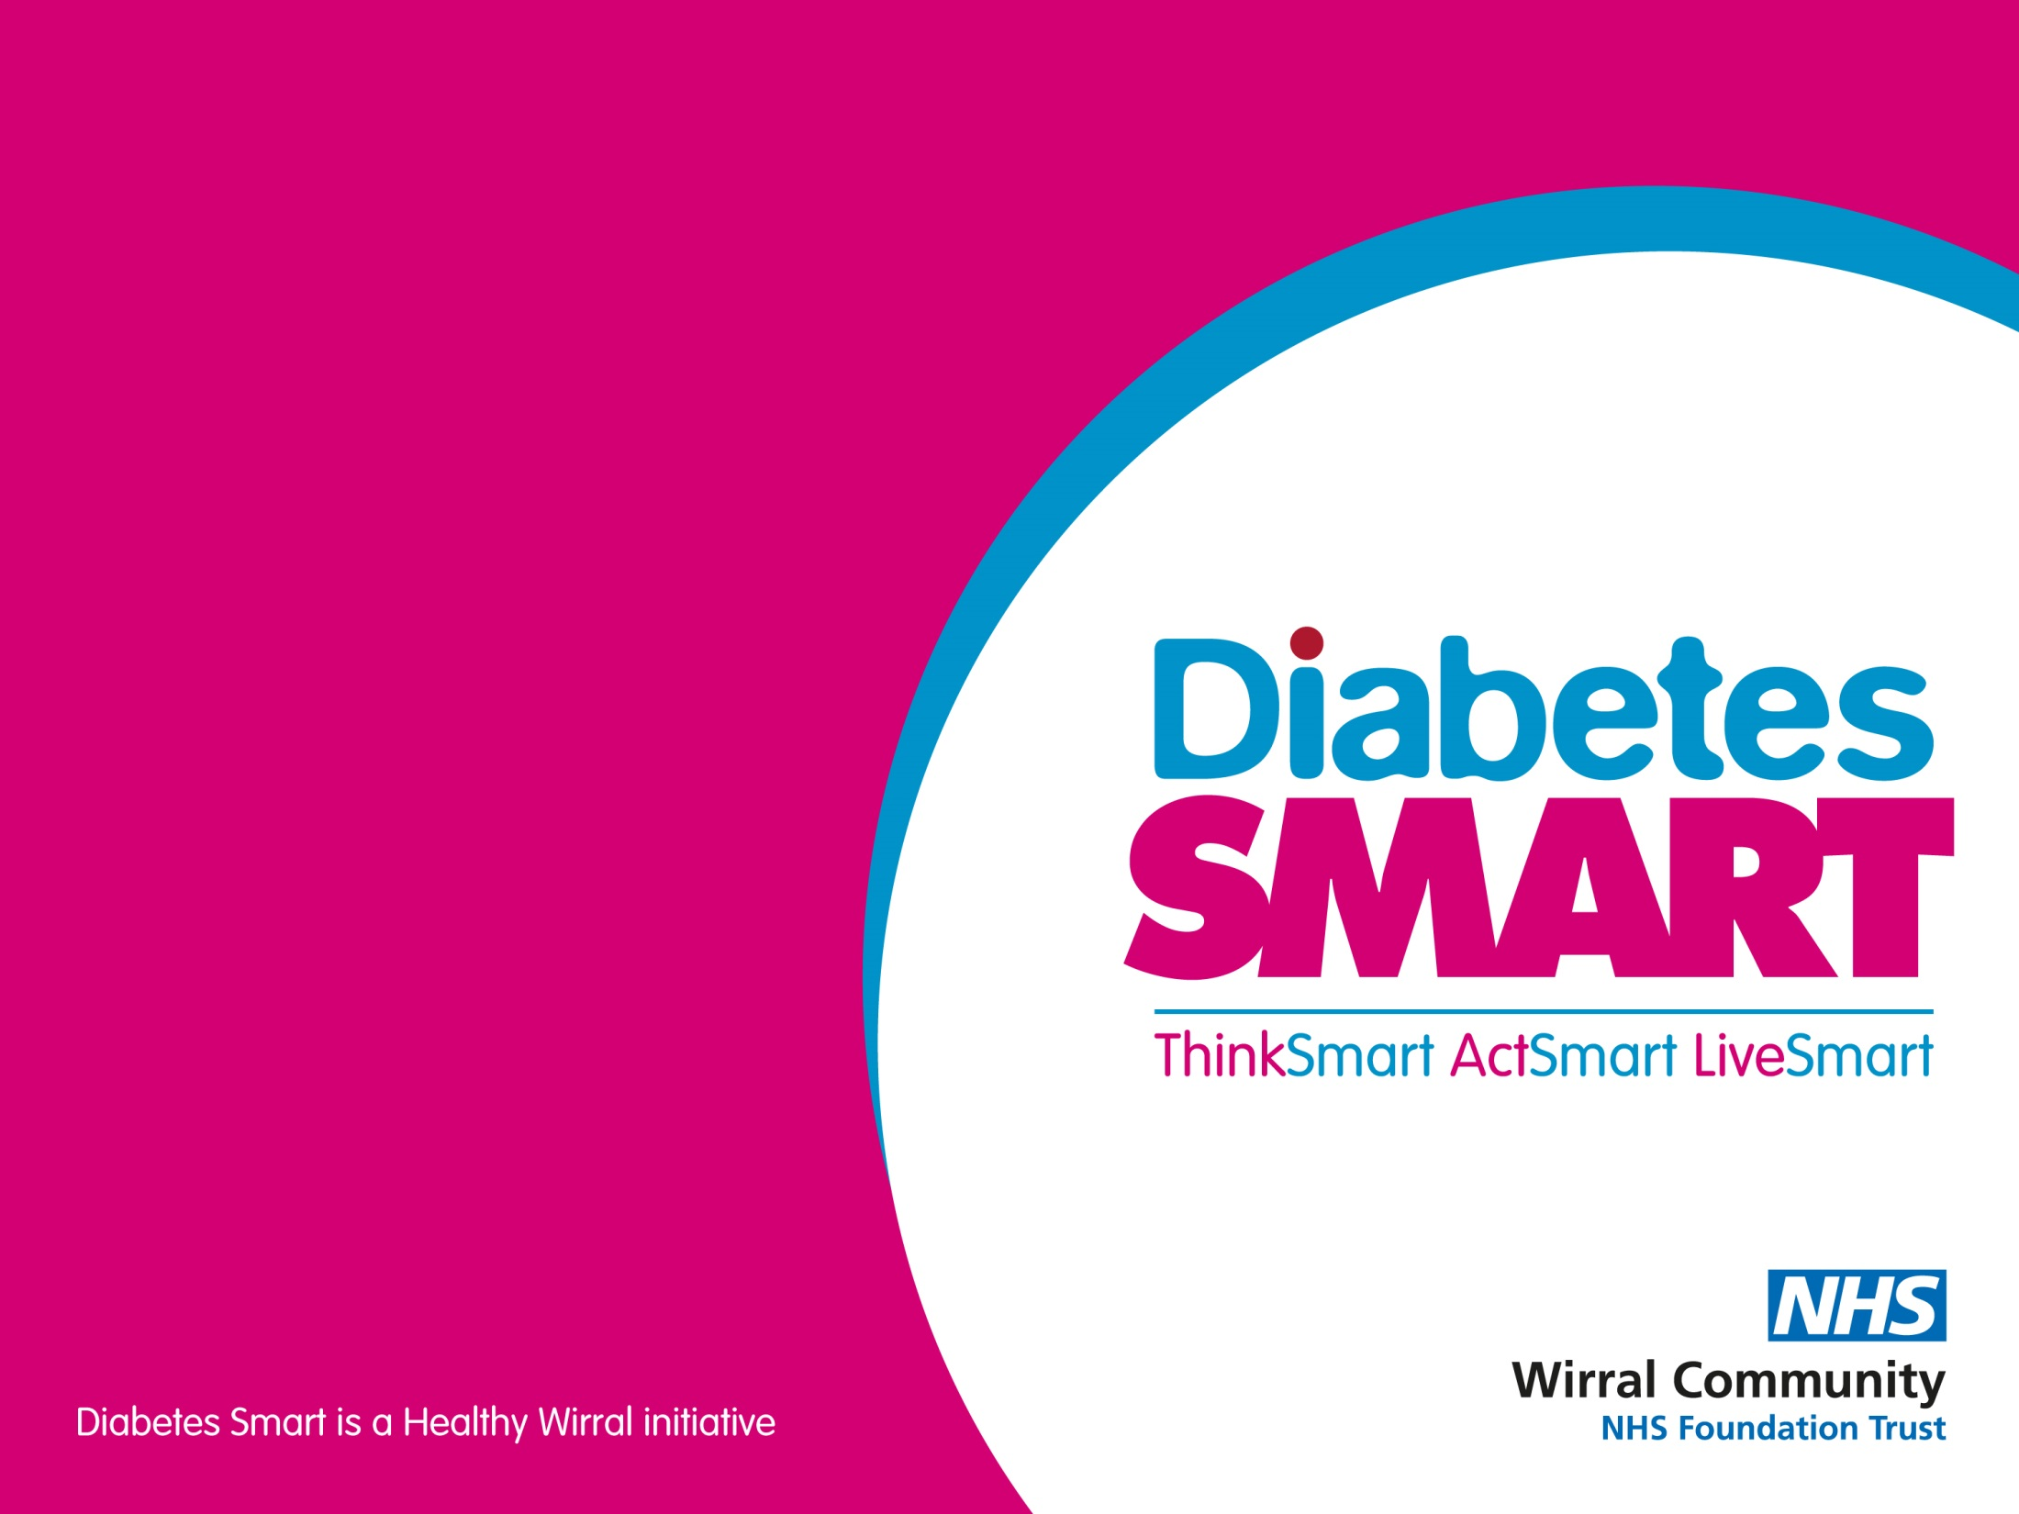

Keeping well with Diabetes
Part 2 – Hyperglycaemia
and managing illness
Presented by:
Helen Hackett
Advanced Dietitian

Slide 2
Hyperglycaemia
Blood glucose level of above 7mmol/l before meals
or above 8.5mmol/l (for type 2 diabetes) or 9mmol/l (for type 1 diabetes) 2 hours after
eating.
However, individualised blood glucose targets should be set for each person
Find out more about monitoring blood glucose levels at
www.diabetes.org.uk/guide-to-diabetes/managing-your-diabetes/testing
and in the Diabetes Smart Keeping well part 3 recording

Slide 3
Symptoms of hyperglycaemia
Passing more urine than normal, especially at night
Urine infections
Thirst and dry mouth
Headaches
Blurred vision
Tiredness and lethargy
Warm and sweaty
Delayed healing of cuts and injuries

Slide 4
Possible causes of high blood glucose levels
Missed a dose of diabetes medication/insulin
Eaten more carbohydrate than body and/or medication can cope with
Less activity than usual
Stress
Over-treating a hypo
Illness
Some medications including steroids and some anti-depressants

Slide 5
Preventing high blood glucose levels
Be aware of carbohydrate portions
When ill, monitor blood glucose levels more closely, continue taking diabetes medication
even if not eating, and contact diabetes healthcare team if need more information.
Be regularly active
Remember to take insulin and diabetes medication, and always take them correctly.
May need more medication – discuss this with diabetes healthcare team.

Slide 6
Sick day rules
Continue to take insulin or diabetes tablets (except SGLT2 inhibitors)
Test blood glucose levels more regularly
Check urine/blood for ketones if blood glucose is 15mmol/l or more
(mainly in type 1 diabetes)
Drink plenty of unsweetened drinks to avoid dehydration
Eat little and often
If necessary, replace meals with snacks or drinks containing carbohydrates
Contact health care team if in any way unsure about what to do,
especially if vomiting, or unable to keep fluids down.

Slide 7
Keeping Well with Diabetes
For more information take a look at the other keeping well with diabetes recordings or book on to Diabetes Smart

