Slide 1
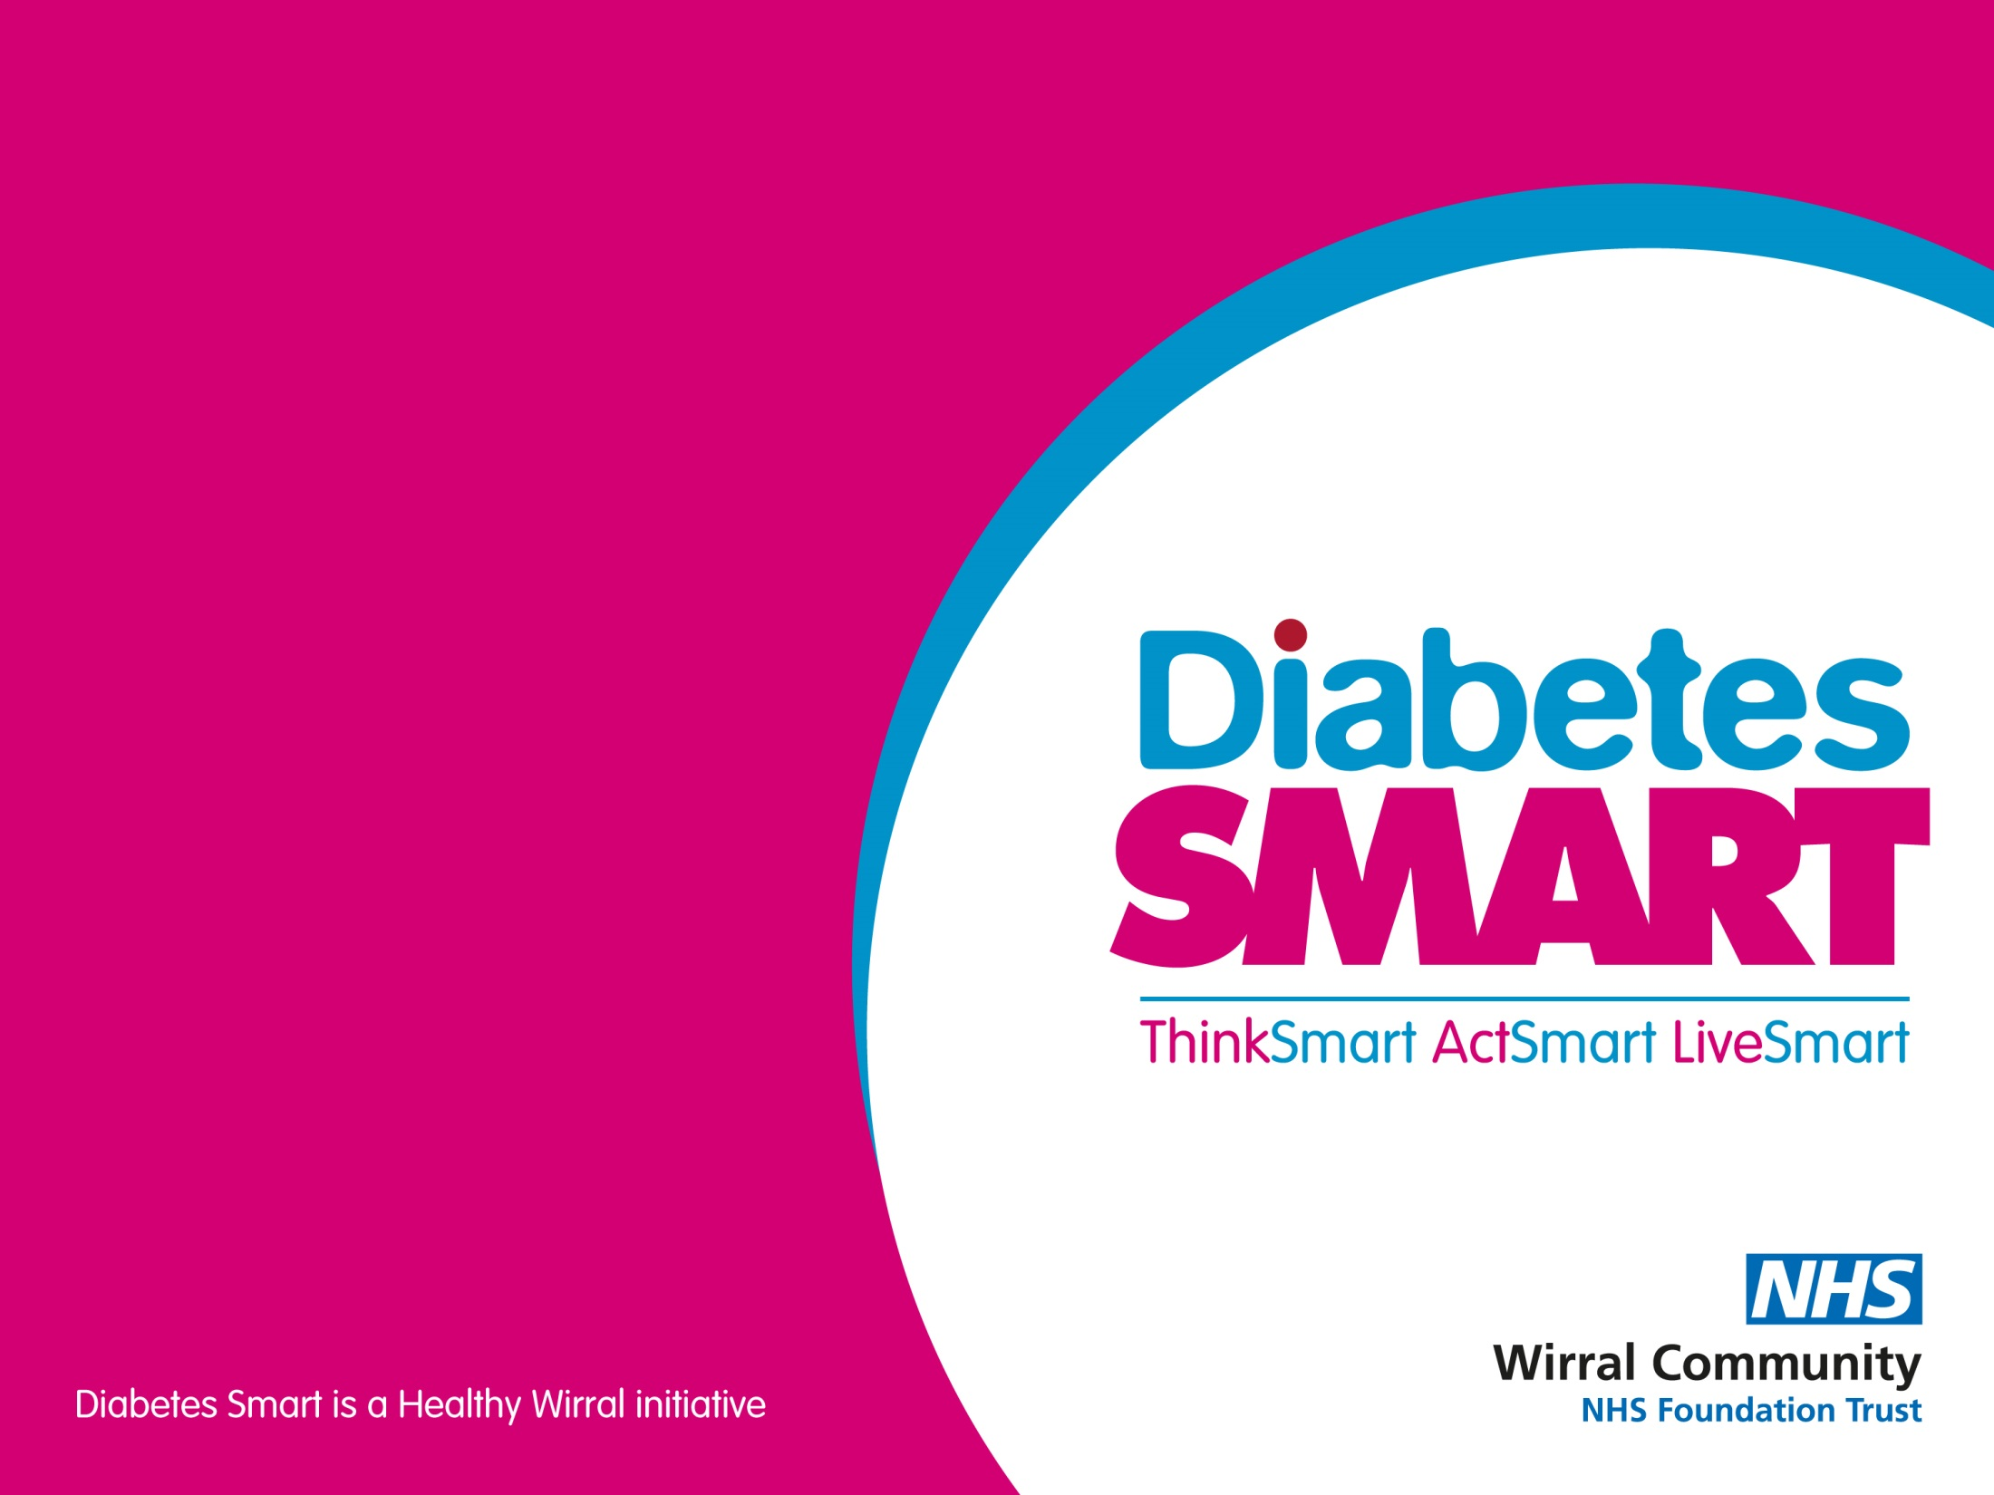
Keeping well with Diabetes
Part 1 – Complications
Presented by:
Dietitian

Slide 2
Health risks with Diabetes
High blood glucose, high blood pressure and high blood fat levels damage the blood vessels, nerves and circulatory system.
High blood glucose levels and Diabetes can affect all organs and systems in the body and increase the risk of health problems
Cardiovascular Disease
Kidney (Renal) Disease
Eye Disease (Retinopathy)
Foot disease (including neuropathy)
Autonomic Neuropathy
Dental Problems

Slide 3
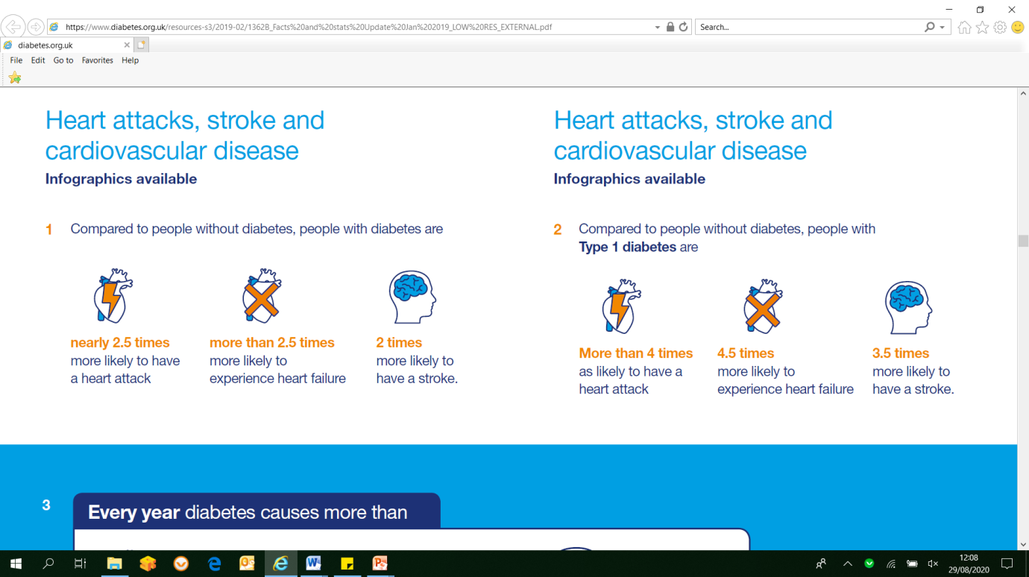
Health Risks with Diabetes
Cardiovascular Disease
Heart disease, heart attack, stroke, peripheral vascular disease, problems with circulation
Risk Factors Include
Non-modifiable risk factors: age, sex, genetics
High blood pressure
High blood glucose levels
Raised cholesterol
Excess weight
Smoking
Unhealthy diet
Data and infographics supplied by Diabetes UK

Slide 4
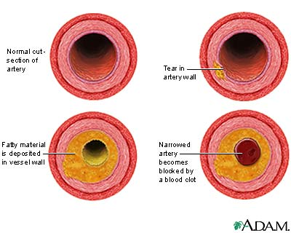
Cardiovascular Disease - Atherosclerosis
Damage
↑Blood pressure, ↑cholesterol, irritant: smoking, high blood glucose
Fatty deposit
Harden (oxidisation)
Narrowing of arteries
Or rupture
Complications
Heart event, angina, stroke

Slide 5
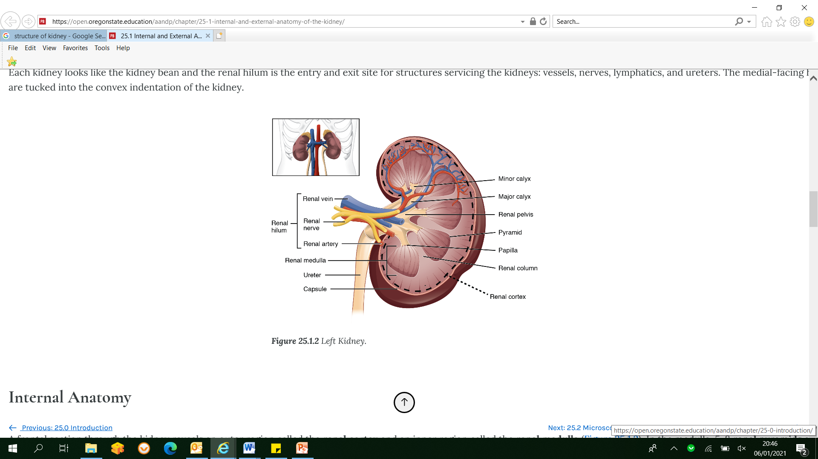
Health Risks with Diabetes
Kidney Disease
Kidney acts as a filter
Kidney disease (nephropathy)
is when the kidneys start to fail
Kidney disease is caused by damage
to small blood vessels in the kidneys.
High blood glucose and
high blood pressure increases
the risk of damage
https://open.oregonstate.education/aandp/chapter/25-1-internal-and-external-anatomy-of-the-kidney/

Slide 6
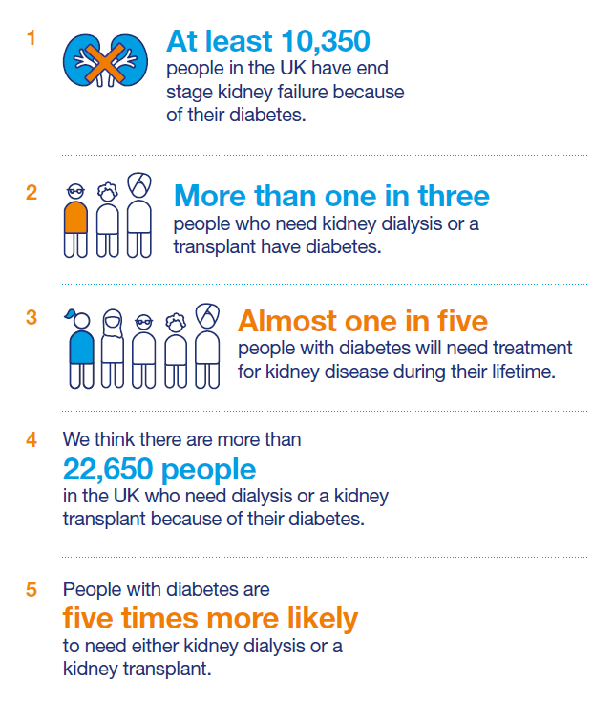
Health Risks with Diabetes
Kidney Disease
Kidney disease can lead to kidney failure
Increased risk with diabetes and high blood pressure.
In the early stages kidney disease does not
usually have symptoms
Early stages of kidney disease can be detected
with urine test (ACR) and blood test – eGFR
As kidney disease progresses, the kidneys become
less and less efficient and the person can become very ill.
For end stage kidney disease dialysis or
kidney transplant may be needed.
Good blood glucose and blood pressure control
protect the kidneys
Data and infographics supplied by Diabetes UK

Slide 7
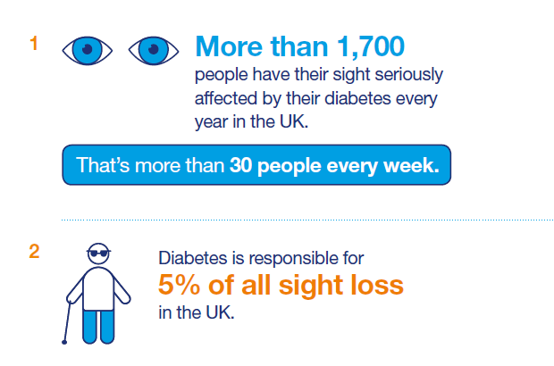
Health Risks with Diabetes
Eye Disease
Eye disease which could lead to blindness
High levels of glucose can lead to damage in your eyes.
Smoking increases risk
As damage progresses sight is affected and it can result in blindness.
Data and infographics supplied by Diabetes UK

Slide 8
Health Risks with Diabetes
Eye disease – detection and treatment
Yearly retinal screening to identify any early signs of problems
Laser therapy is a common treatment
Good blood glucose and blood pressure management can successfully maintain vision
It is important to stop smoking

Slide 9
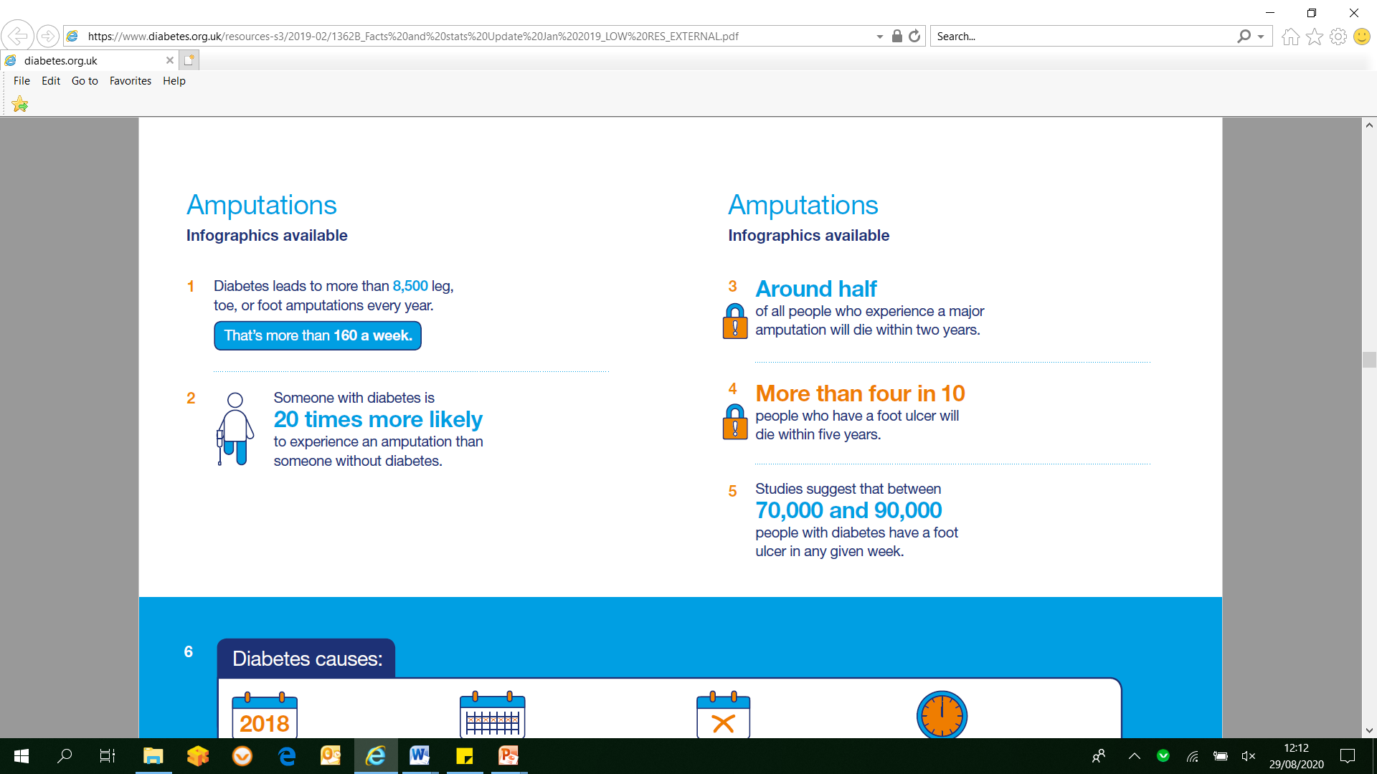
Health Risks with Diabetes
Foot Disease
Problems with the feet, which could result in amputation
raised blood glucose can cause problems with sensation and circulation.
Data and infographics supplied by Diabetes UK

Slide 10
Health Risks with Diabetes
Foot Disease
Nerve damage is known as neuropathy
Symptoms can include:
Tingling and numbness
Loss of ability to feel pain
Loss of ability to detect changes in temperature
Loss of coordination – when you lose your joint position sense
Burning or shooting pains – these may be worse at night time.
Without a good blood supply, you may have problems with cuts and sores, as your feet will be less able to heal well.
High blood pressure, unhealthy diet and smoking increase the risk of poor circulation
Data and infographics supplied by Diabetes UK

Slide 11
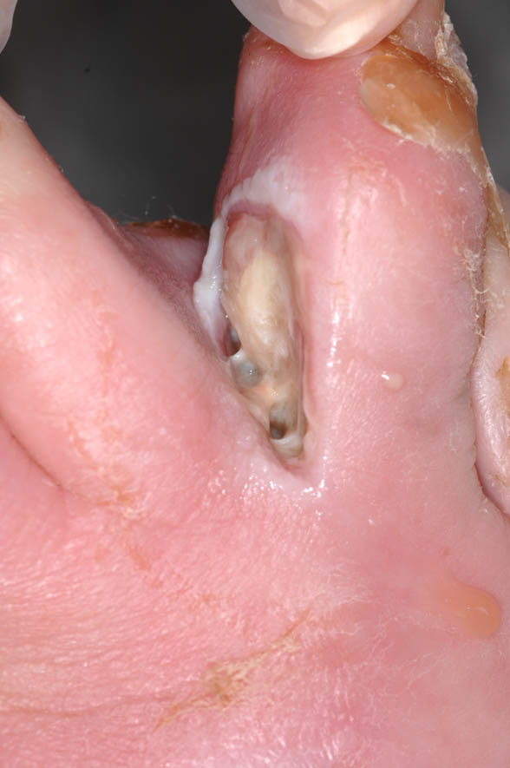
Health Risks with Diabetes
Foot Disease
If left untreated can result in foot ulcers and
infections and, at worst, may lead to amputations.
May also suffer from cramp and pain in legs
and/or feet as a result of poor circulation.
Most foot problems are preventable with good,
regular foot care
Data and infographics supplied by Diabetes UK

Slide 12
Health Risks with Diabetes
Foot Care
Attend your regular foot check and know the result
Avoid walking bare foot and direct contact with heated surfaces
Don’t use corn removing plasters or blades
Make sure socks and shoes fit and do not rub
Manage diabetes
Stop smoking
Check feet every day
Data and infographics supplied by Diabetes UK

Slide 13
Health Risks with Diabetes
Foot Danger Signs
Foot red, warm or swollen
A break in the skin or any discharge (or oozing) onto your socks or stockings
Feel unwell
Remember you may not experience pain even with a visible wound.
Contact your GP or Foot Protection Service immediately.
If they are not available and there is no sign of healing after one day, go to your nearest out-of-hours healthcare service or your A&E department.

Slide 14
Health Risks with Diabetes
Autonomic Neuropathy
Nerve damage as a result of high blood glucose levels damaging the small blood vessels which supply the nerves.
Autonomic neuropathy affects nerves that control functions without you consciously directing them, such as stomach emptying, bowel control, heart beating, sexual organ function.
There are many treatments available to relieve the symptoms caused by neuropathy.
Good management of blood glucose levels can improve the symptoms of neuropathy and can reduce the progression of the nerve damage.

Slide 15
Health Risks with Diabetes
Other Health complications
Mental Health
Dental Health
COVID 19 complications

Slide 16
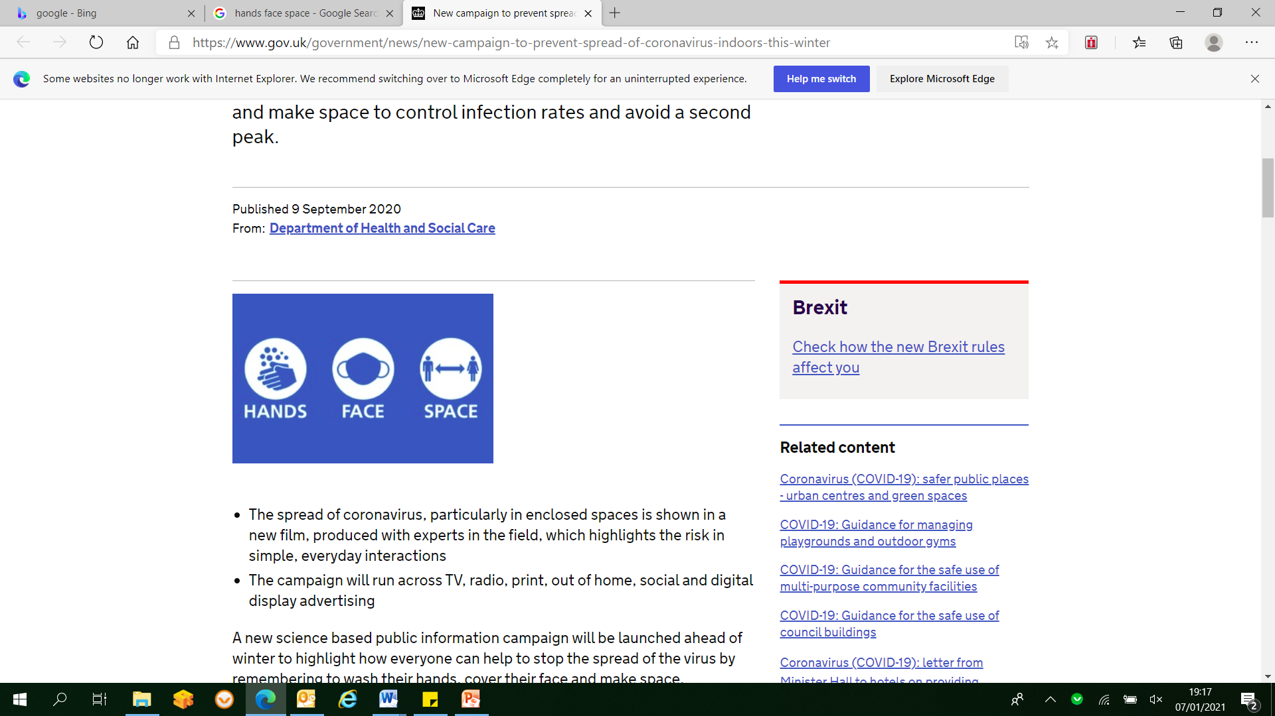
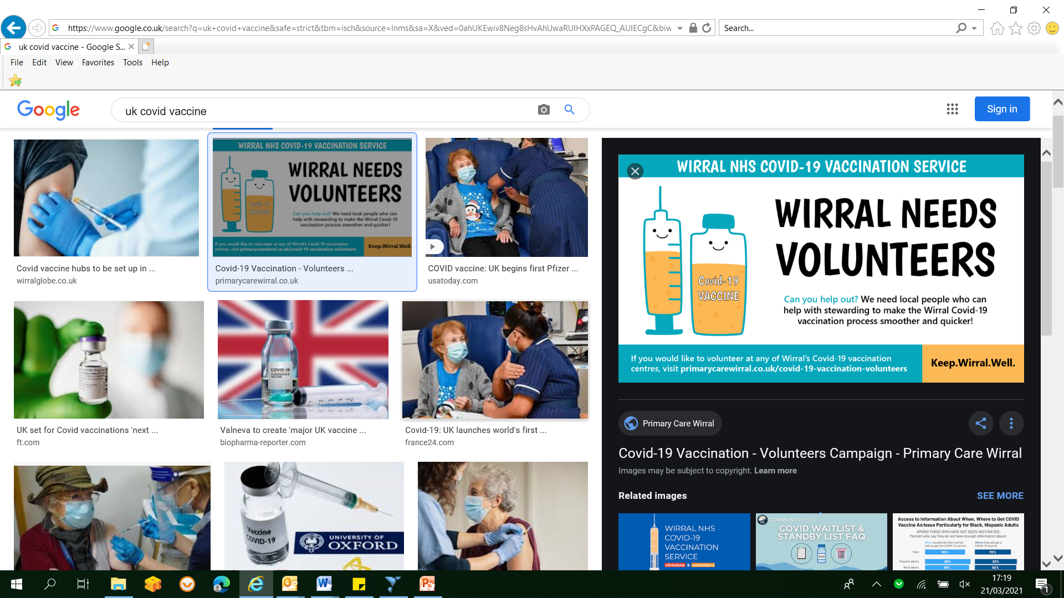
Health Risks with Diabetes
Coronavirus (COVID-19) complications
If you have Diabetes you are no more likely than anyone else to catch coronavirus.
We can all protect ourselves and each other by following public health guidance
and being vaccinated
Diabetes makes people more vulnerable to developing a severe illness if they do get coronavirus
To reduce your risk of more severe illness if you do get COVID 19 losing any excess weight and improving blood glucose levels are both important
If you do get COVID 19 follow the sick day rules discussed and seek medical advice if you are unsure how to manage your diabetes while unwell

Slide 17
Keeping Well with Diabetes
For more information take a look at the other keeping well with diabetes recordings or book on to Diabetes Smart

