Slide 1

Carbohydrate Awareness
Types of Carbohydrate
Presented by:
Community Dietitian

Slide 2
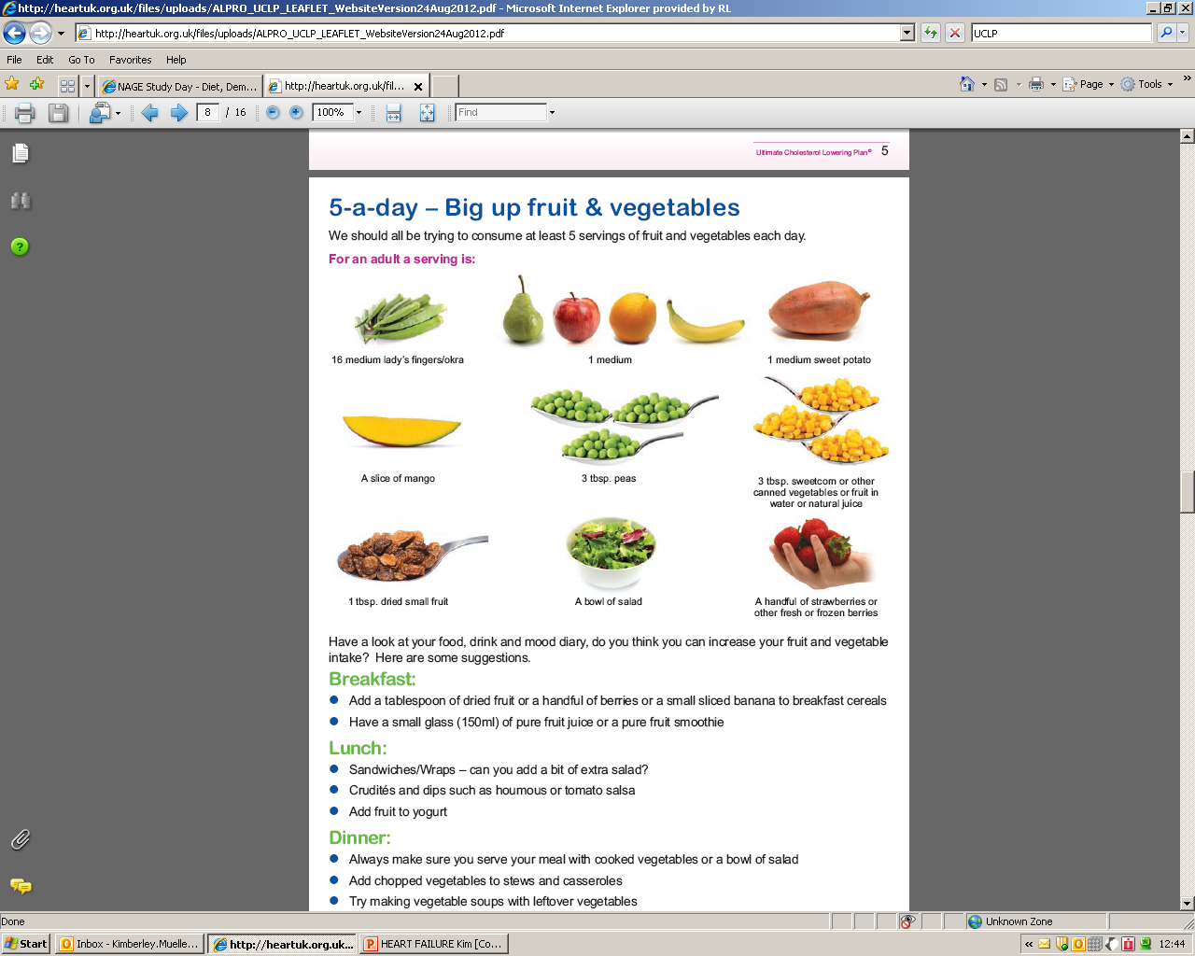
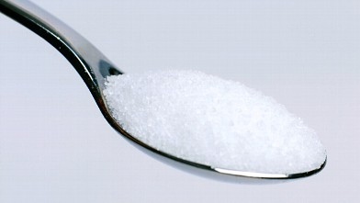
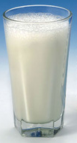
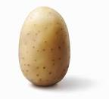
1 potato (egg-sized)
2 teaspoons sugar
1 medium orange
1/3 pint (200ml) milk
All of these food portions contain 10g of carbohydrate
and so would raise blood glucose levels by a similar amount

Slide 3
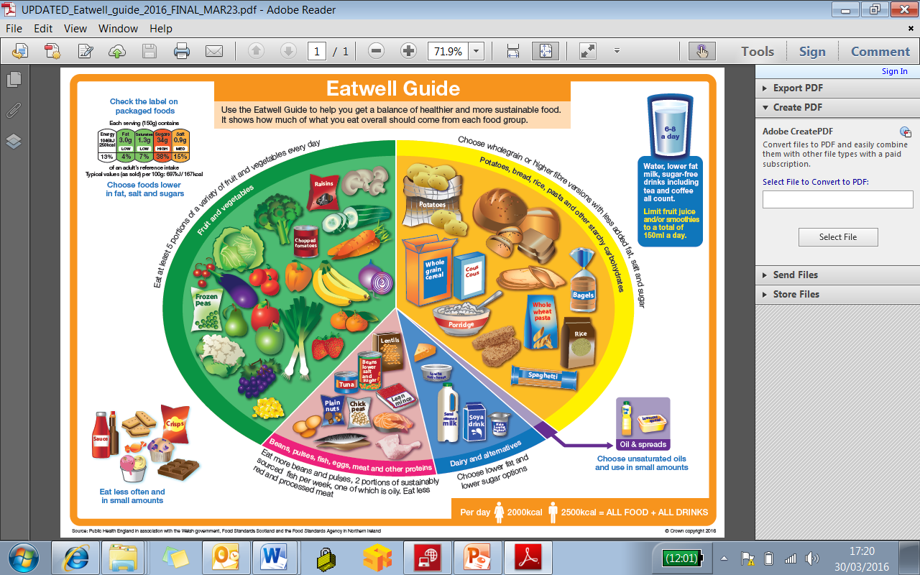

Starch | Added/free sugars | Natural sugars
bread rice potato pasta noodles breakfast cereals oats couscous yams corn lentils and legumes plain biscuits and buns crackers anything made with flour such as pizza, pastry and thickened sauces and soups. | granulated sugar (brown/white) sweets chocolate jams/preserves sugary soft drinks honey syrups fruit juice jelly cakes* desserts* biscuits* | Fructose fruit (fresh, dried, tinned and juice) | Lactose milk dairy foods like yoghurt, fromage frais and ice cream

Slide 4
Sugar
Does not contain anything beneficial for health
Adds extra calories
Bad for dental health
As a general rule, everyone should be eating less sugar.

Slide 5
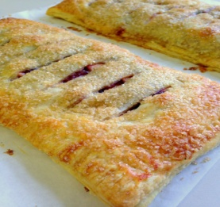
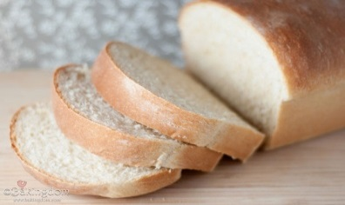
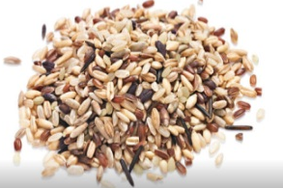
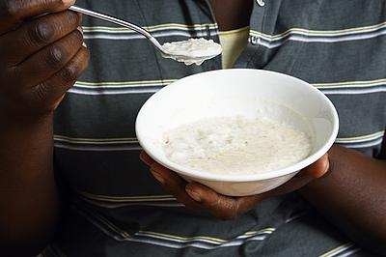
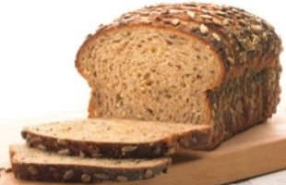

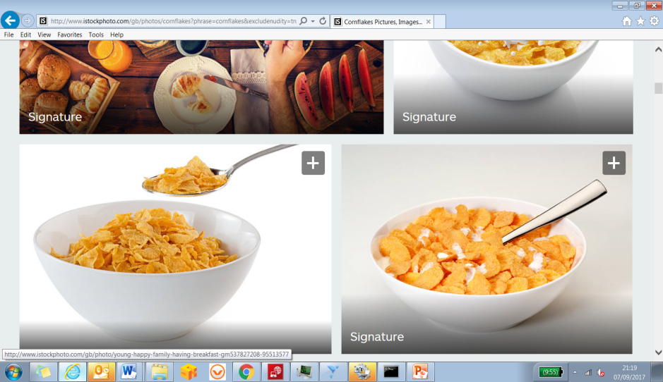
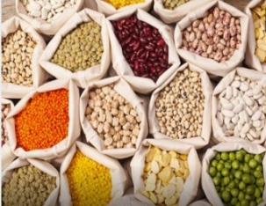
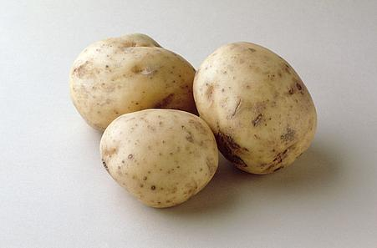
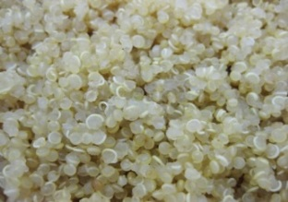
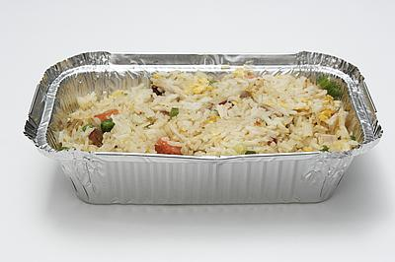


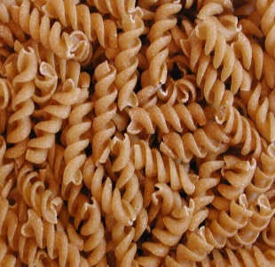
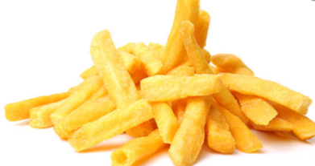
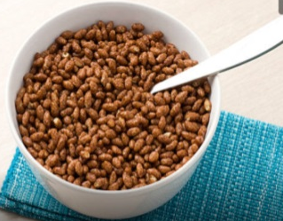
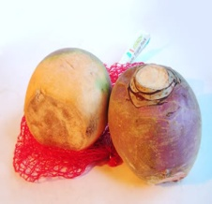
Starchy and sugary foods
Quick burst of energy
Hungry again quickly
Low in vitamins, minerals and fibre
Steady supply of energy
Feel full for longer
High in vitamins, minerals, fibre and some have protein

Slide 6
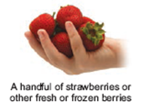
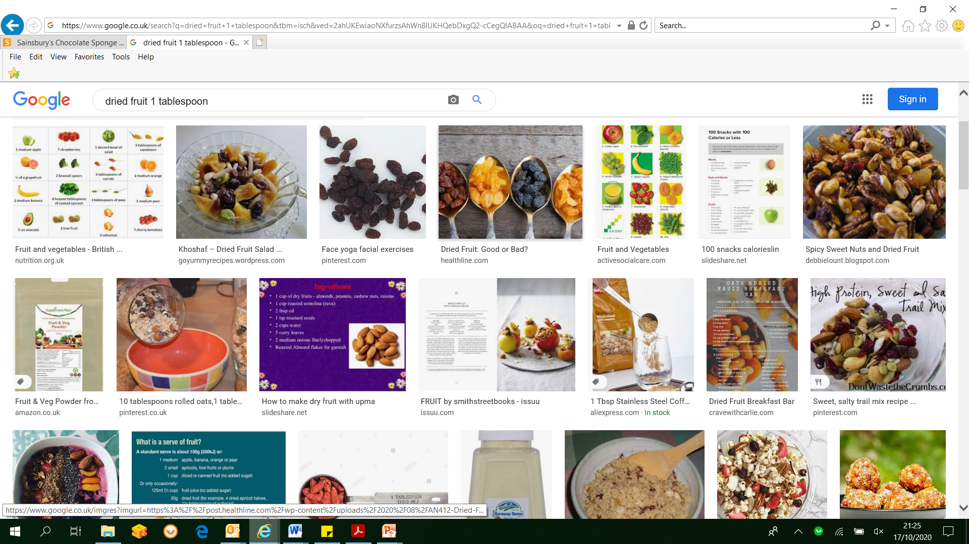
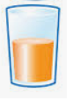
Fruit
Does not have to be avoided
Does contain natural sugar so avoid large amounts
A portion of fresh fruit is the amount that fits in your cupped hand
The portion size for dried fruit is smaller: one tablespoon
Try to limit/avoid fruit juices and smoothies or keep to a maximum of 1 small glass a day

Slide 7
Fibre
Good for digestive health
Associated with a lower risk of cardiovascular diseases, type 2 diabetes and bowel cancer
Linked with improving blood glucose levels, blood fat levels and blood pressure
Keeps you feeling fuller for longer
Even though higher fibre options have health benefits they still contain carbohydrate - Be mindful of portion size.

Slide 8
Carbohydrates
For more information about carbohydrates take a look at the other carbohydrate awareness recordings or book on to Diabetes Smart.

